Slide 1
Development of SIAP database of training resources Network for the coordination of statistical training in Asia and the Pacific
Ministry of internal affairs and communications
Government of japan

Slide 2
Overview of the database
Economic and Social Commission for
Asia and the Pacific
Coordination of requests and
opinions for improvement etc.
Request for development of statistical training resource database
Statistical Institute for
Asia and the Pacific
Training Resources
-Overview of the course
-Experts
-Materials etc.
Checking input data Grasp demand / improvement
opinion etc.
DATABASE
Internet
Data input, information sharing Suggestions of improvement
NSOs / NSS
Statistical Institutes
International Organizations

Slide 3
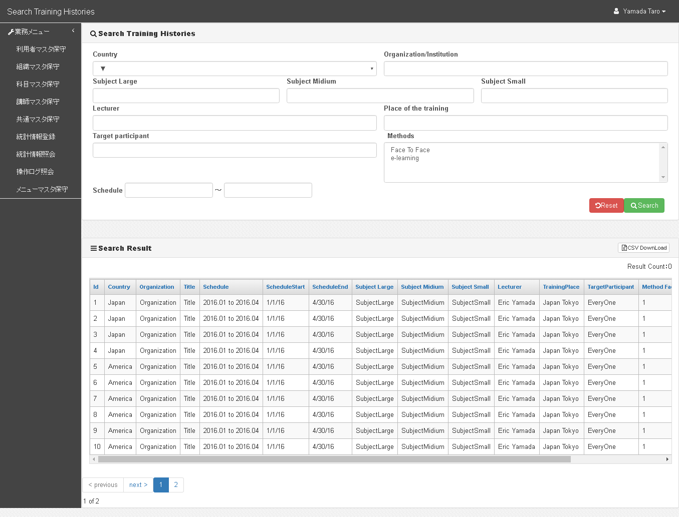
Contents to be included in the database
Country
Organization / Institution
Training subject
Experts
Place of training
Target participant
Training methods (Face to face, e-learning etc.)
Schedule
Training overview
etc.

Slide 4
The database is like this…
The database will launch internally with major browsers such like Firefox, Chrome, Internet Explorer and Safari.
SIAP will be responsible for the authentication process as secretariat of the database.
Information on completed programmes will be accumulated.
Training Programmes will be classified into nine areas of SIAP work.
If you click “search” without selecting any items, the result shows all information.
CVs of statistical experts will be uploaded in pdf format.
Search result is downloadable in CSV format.

Slide 5
Launch schedule
Designing and building of the prototype: August - December 2016
Trial of the prototype: January - March 2017
Inviting comments and suggestions: March 2017
Customizing and testing of the actual database: September – December 2018
Start of the database: January 2019

