Slide 1
Business Demographic Statistics (BDS)
Michael Biddington, Statistician, UN ESCAP Statistics Division

Slide 2
What is BDS?
Like social statistics but for businesses
Identifies major life events
Births
Deaths
Size
Type
Dominated by small business and sole traders

Slide 3
Australian BDS
Published once a year
Five year timeseries
Annual Data
Data Items
  ISIC
  Size (employees & turnover)
  Location
  Alive status
  Registration type’s

Slide 4
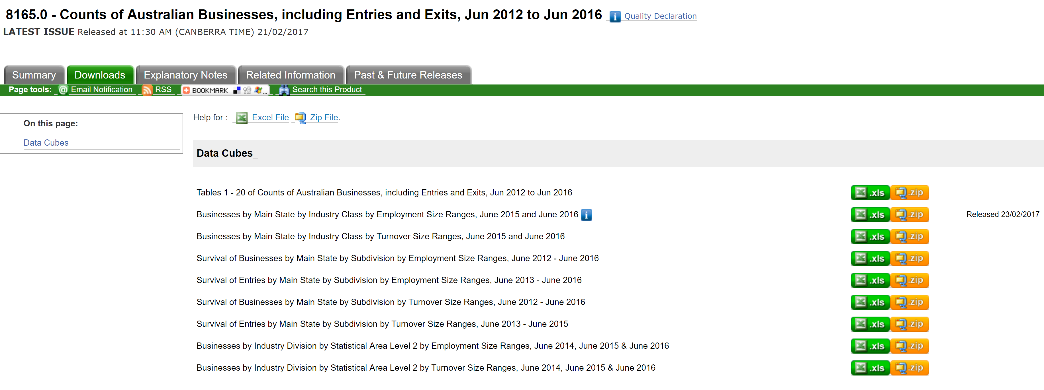
Data files

Slide 5
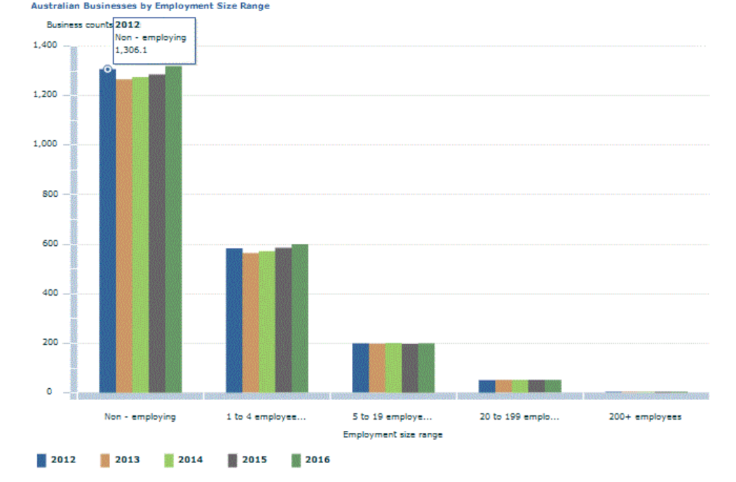
Size Ranges – Headcount

Slide 6
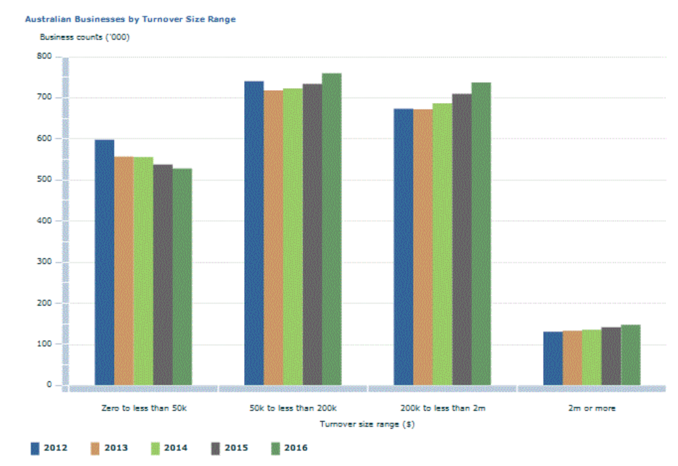
Size Ranges – Turnover

Slide 7
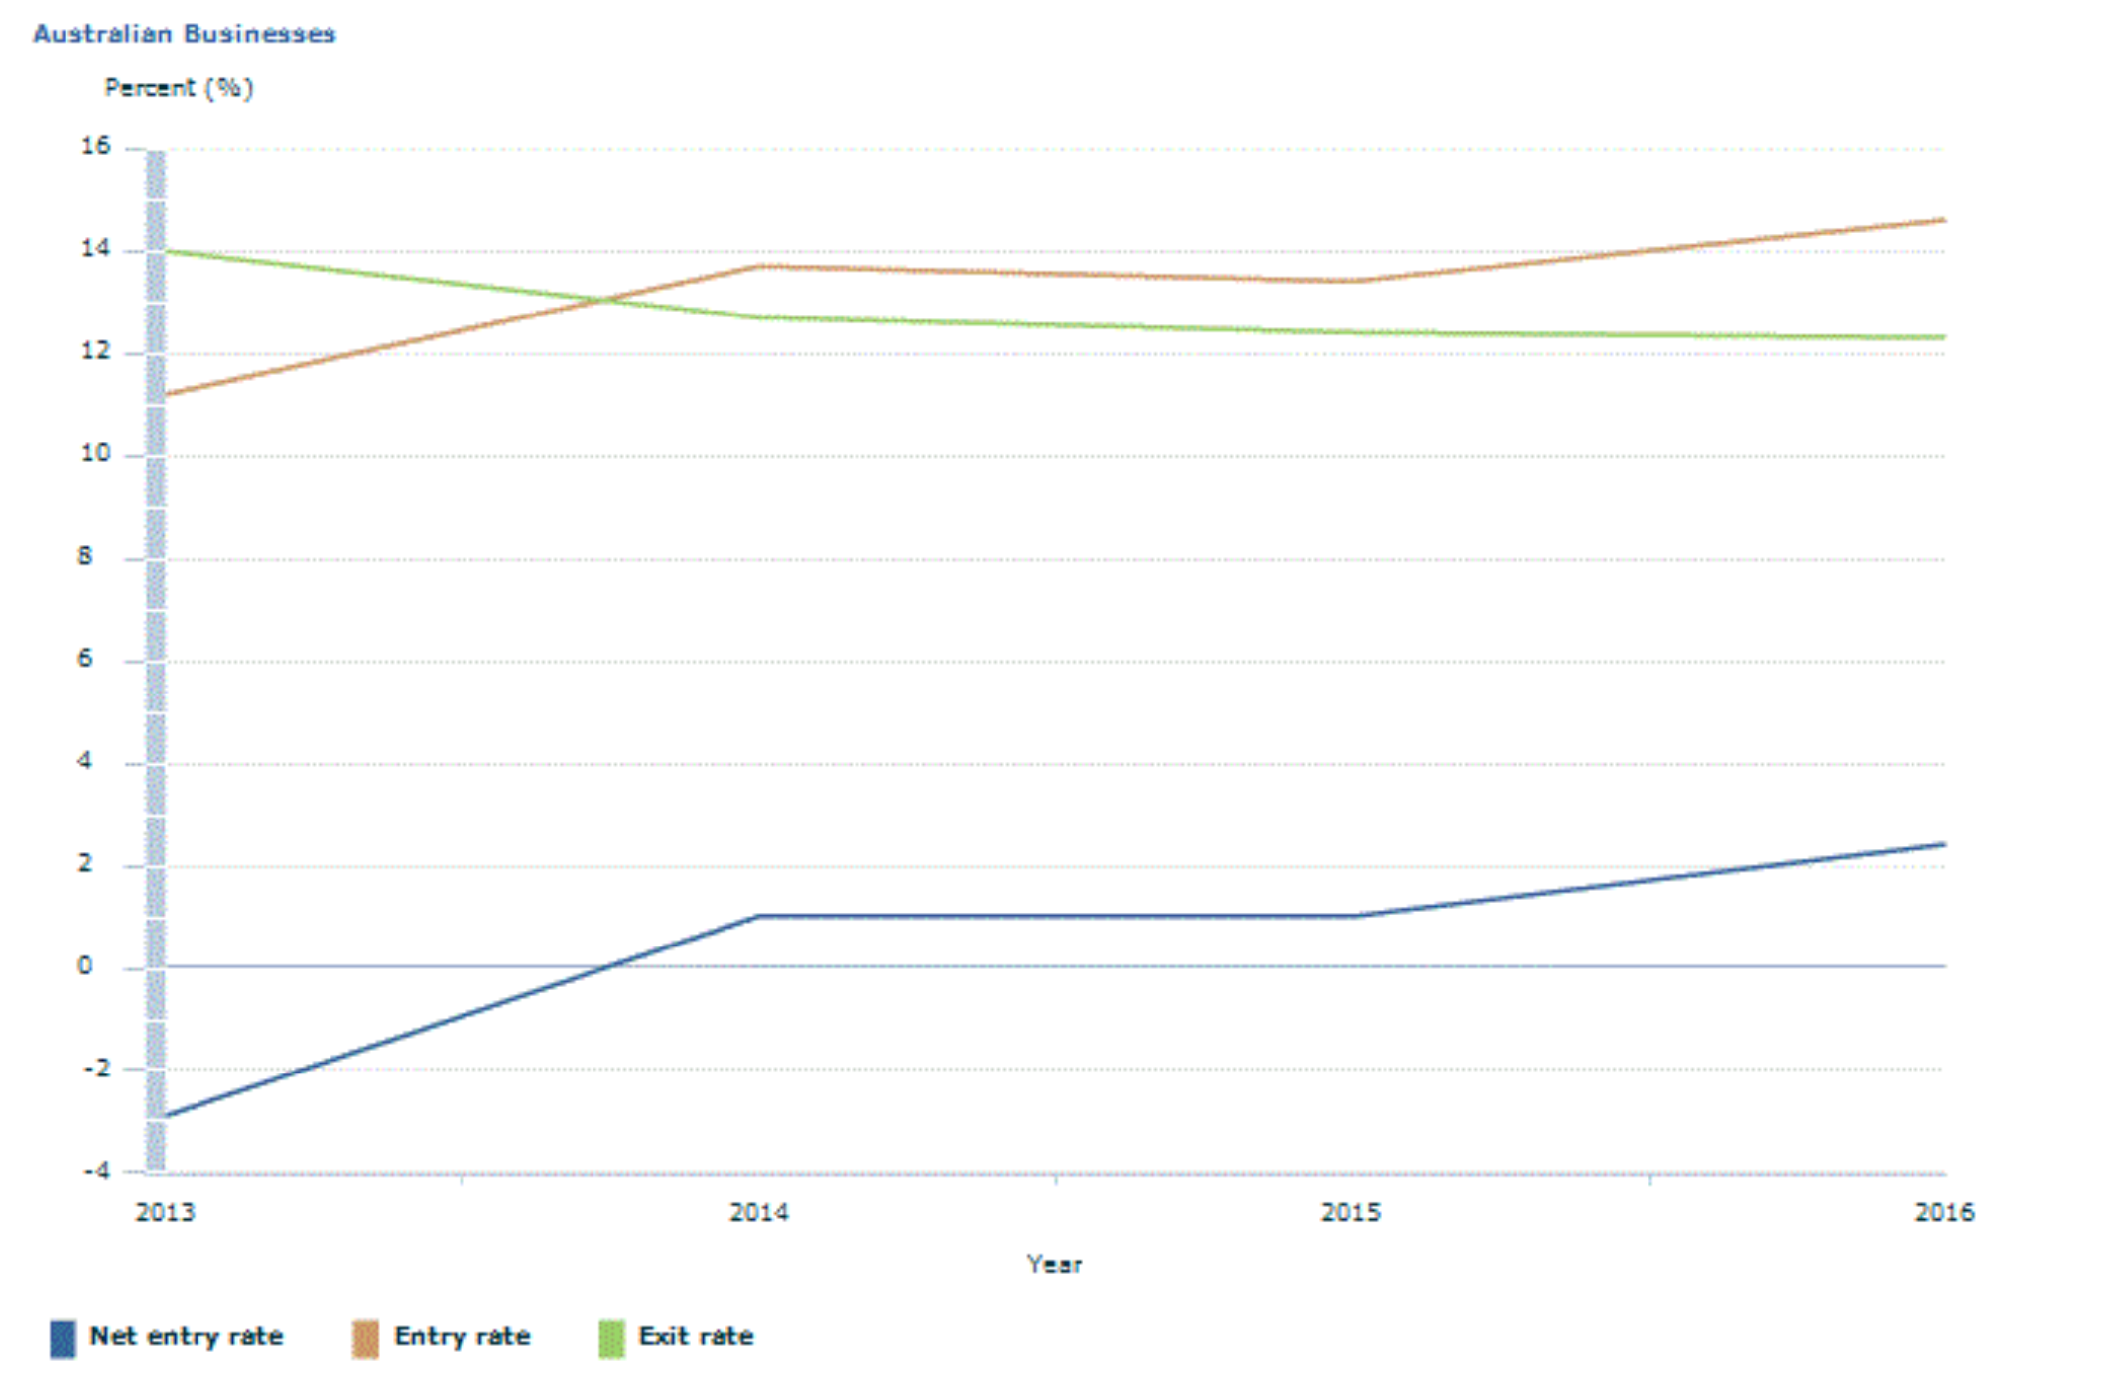
Survival Rates

Slide 8
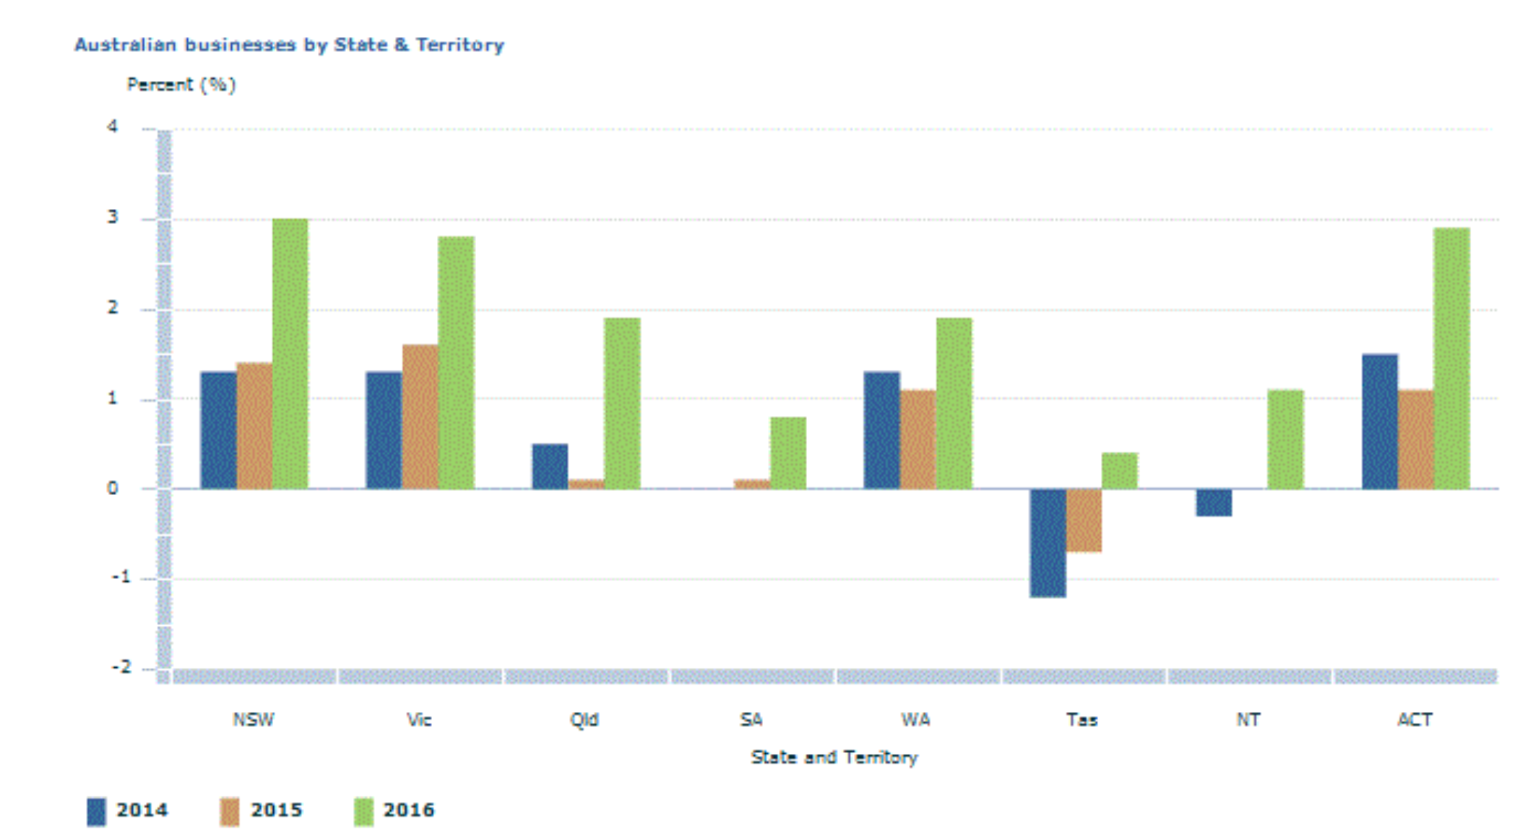
Locations

Slide 9
Location data
Coded using ‘business address’
Often the headquarters of a business
Okay for small businesses
Published at low level geographies
Statistical Area Level 2 (SA2)
Approximately 10-20,000 people per SA2

Slide 10
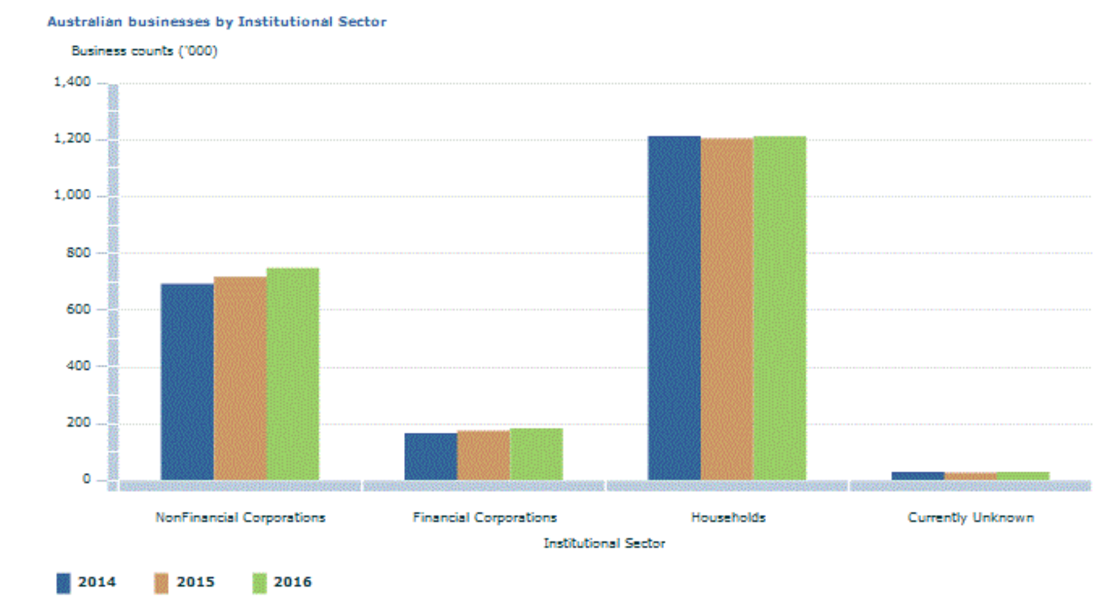
Type of Businesses

Slide 11
Why Annual?
We quarterly frozen frames but…
People only have to report once a year
Employment estimates once a year
Headcount estimates once a year
Anything sub-annual would be misleading.

Slide 12
Why Ranges
Outlier results are common
Ranges hide data errors
Financial sector
Growth rates are difficult to publish in a meaningful manner
  Part year reporting
  Change in activity
  Small base (high growth rates)

Slide 13
Confidentiality
Lower concern
But we have reputation to maintain
No unit record data should be identifiable
Rule of 3 - lowest values are (0,3).
Perturbation
Table-Builder

Slide 14
Issues with Australian BDS
Legal entity basis
  Not establishment
  Supermarkets
Location data
  Not high quality
Scope
  Peoples expectations
  Property investment

Slide 15
Production methods
SAS computer code
Use one Frozen frame per year
Combined data set has value for each year
Except ISIC / Type / Location – simplify
Changes historical data

Slide 16
Quality checks
Publication has high error rate
  Employment estimator
  Location mapping
  Scoping (Invalid ISIC)
Know your data!
Timeseries analysis
Compare with other published data

Slide 17
Feedback from users
Many errors identified by users
Communicated to us privately
Many eyes help quality
Users need help with understanding data
Explanatory notes have changed often

Slide 18
Consultancy
ABS does sell custom data sets on BDS
  Companies
  Other government department
  Minister requests
Industry analysis
Often say no
  Too much confidentiality / perturbation
  Propose different product to meet client needs
  Charge by data cell &

Slide 19
Q&A
Thank you

