Slide 1
Ideal SBRs and the Australian SBR
Michael Biddington, UN ESCAP Statistics Division, Biddington@un.org

Slide 2
What is an Ideal SBR?
What does it mean?
Depends on what we trying to achieve?
How do we define it?
Data collected
System
Processes
Data products
People
Cost

Slide 3
Norway’s SBR
Administrative data heaven;
Population Register
Address Register
Business Register
All linked – unit record.
All done by other agencies
High data quality and accuracy

Slide 4
Norway's SBR

Slide 5
Norway's – SBR
Many useful statistical purposes (Census)
Viewed as a giant SBR.
Stats Norway knows;
Employees – Wages, education, gender, etc
Locations – businesses and employees.
Tax data
Very low cost & high quality statistics

Slide 6
Norway’s SBR
Stats Norway – minimal work.
Data integration
Legal and institutional frameworks
Compliance

Slide 7
Back to reality…..
This is my dream for Australia.
Population Register
Address Register
Integration of all administrative data
When collected
Only been achieved in Northern Europe

Slide 8
The Australian SBR
Legal entity base
Two populations
Profiled Population
Non-profiled Population
Primary Use – Economic Surveys
Secondary Uses
Turnover, Wages & Employment estimates
Business Demographic Statistics

Slide 9
The Australian SBR – History
1970s
Established to support Economic Census.
1980s
Integrated with agricultural register
Profiling team established
Common frame introduced
2000s
The Australian Business Register (ABR)
Replaced the mainframe with Oracle based platform
2010s - Transformation

Slide 10
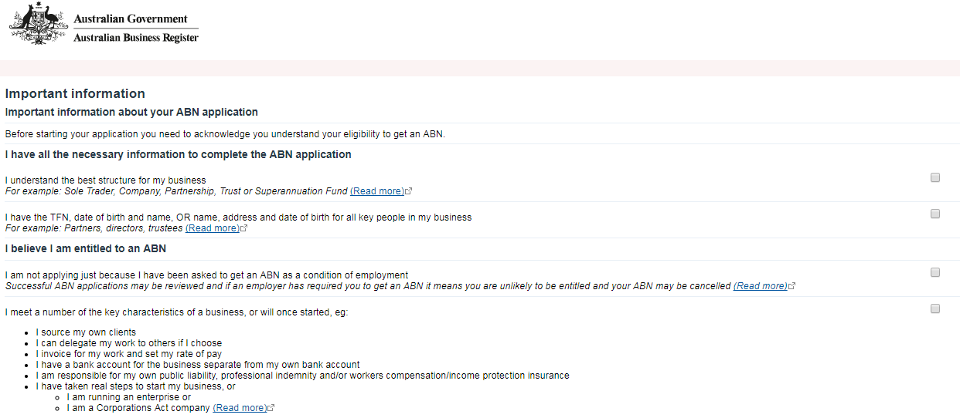
Australian Business Register (ABR)
The ABR is a separate government department.
Unique ID used to identify businesses to everyone
Registration form designed by ABS & ATO

Slide 11
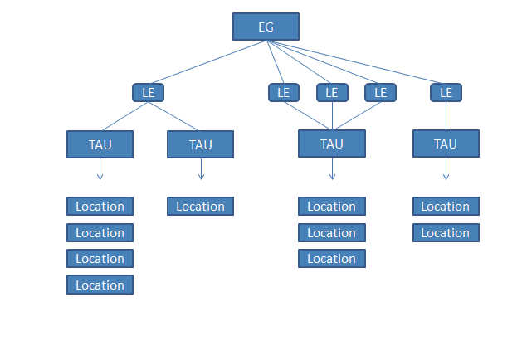
Economic Units Model
Notes:
Comments needing to be made
- What are EG’s, LE’s, TAUs, Locations.
Data only collected available from LE’s and TAUs.
Locations don’t actually exist in SBR. Only one address per LE or TAU.
No ability to collect accurate regional data
Wages & employment by State (7 in Australia are collected).

Slide 12
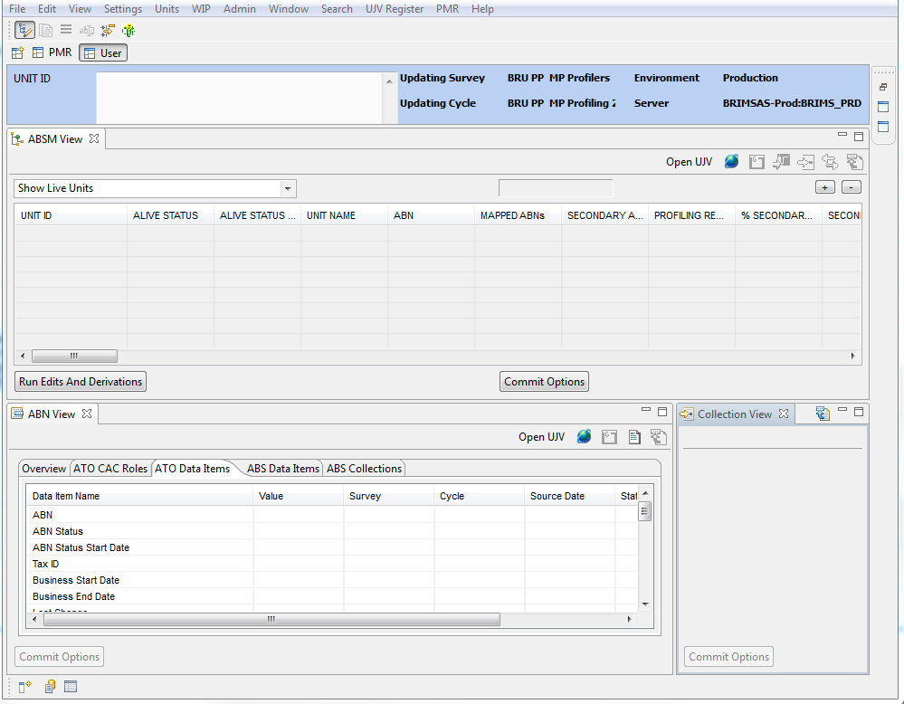
The System (BRIMS)

Slide 13
Administrative Data
Value Added Tax (VAT or GST)
Wages
Company Tax
Alive status
ANZSIC (which is ISIC)
Government Financial Statistics
All at ABN or Legal Entity level

Slide 14
Staffing (Full Time Equivalent)
50 FTE Staff - Melbourne, Australia
6 managers
25 profilers
9 technical staff
10 analysts

Slide 15
Statistical Products
Common & Survey Frames (Quarterly)
Tax Data (Quarterly)
Business Demographic Statistics (Annually)
That’s it

Slide 16
Q&A
Will go into much more detail in next four days.
Thank you!

