Slide 1
Economic Tendency Surveys
Regional workshop on short-term economic indicators and service statistics to support 2008 SNA implementation
25-27 September 2017
Chiba, Japan
Herman Smith
United Nations Statistics Division

Slide 2
Objectives of the presentation
Provide an overview of the Handbook
Background
Overview
Status of preparation
Tendency Surveys
Frequency
Questionnaire
Answering scheme
Data collection methods
Data processing
Metadata and data dissemination

Slide 3
Handbook on Economic Tendency Survey
Economic Tendency Surveys
They are tools used to capture an assessment of the past situation, current situation and expectations on future developments of business and/or consumers.
They are an integral part of an early warning system because they provide information about the occurrence and timing of upturns and downturns of the economy.

Slide 4
Handbook on Economic Tendency Survey
The objective of the Handbook
To provide best practices and harmonized principles on tendency survey covering aspects such as:
sample selection;
questionnaire design;
survey questions;
survey execution;
data processing;
dissemination of results; and
use of the results of tendency surveys.

Slide 5
Handbook on Economic Tendency Survey
Preparation process
A working group was established in 2012:
The Italian National Statistical Institute (ISTAT) (lead institution)
The KOF Swiss Economic Institute
Statistics Netherlands (CBS)
Philippine Statistical Authority
The Organisation for Economic Co-operation and Development (OECD)
UNSD
A draft was prepared and reviewed by experts during the period January 2013 - May 2014

Slide 6
Handbook on Economic Tendency Survey
Preparation process
28 July- 29 August 2014: Global Consultation with countries, international/regional organizations, and other relevant institutions took place during the period
Responses:
65 responses were received
Overall there was a strong support for the Handbook: the responses were extremely positive and a number of useful comments were received.
Summary report is available at:
http://unstats.un.org/unsd/nationalaccount/gcItemETS.asp

Slide 7
Handbook on Economic Tendency Survey
Preparation process
October 2014 - March 2015: revisions of the draft by ISTAT and UNSD
May-June 2015: final review by the working group
Summer 2015: submission for publication
The handbook is available online at: https://unstats.un.org/unsd/nationalaccount/docs/ETS_Handbook_Final.pdf
Consultative and transparent drafting process!

Slide 9
Outline of the Handbook
Chapter 1: Introduction
Chapter 2: Scope of Economic Tendency surveys
Chapter 3: The questionnaire design
Chapter 4: Survey frame and sample design
Chapter 5: Estimation procedures and accuracy
Chapter 6: Data collection
Chapter 7: Managing sources of non-sampling errors
Chapter 8: Processing tendency survey data
Chapter 9: Data dissemination and publication
Chapter 10: Use of tendency survey results

Slide 10
The Handbook is based on existing work by international/regional organizations and countries’ experience:
Joint Harmonized EU Programme of Business and Consumer Surveys (Directorate-General for Economic and Financial Affairs)
Business Tendency Surveys - A Handbook (OECD)
Country experience compiling these surveys

Slide 11
What are tendency surveys?
Surveys aimed at collecting (mainly qualitative) information on the assessment of the current and future economic situation.
They are an important tool for economic monitoring, short-term forecasting and economic research.
Main features of tendency surveys:
Simplicity of the questionnaire
Assessment mainly provided through qualitative responses
Frequency and timeliness of the responses

Slide 12
Historical development
1920s
Some countries started conducting tendency surveys
1950s
more countries implement these surveys (France, Germany, etc.)
Centre for International Research on Economic Tendency Surveys (CIRET) was founded.
CIRET is a forum for leading economists and institutions concerned with analysing and predicting the development of the business cycle and the economic and socio-political consequences.
1920s
1990s
2010s
1950s
1960s

Slide 13
Historical development
1960s
The European Commission launched the Joint Harmonized EU Programme of Business and Consumer Surveys
1990s
The OECD started a programme on business tendency surveys
2010s
Importance of tendency surveys acknowledged at international level
1920s
1990s
2010s
1950s
1960s

Slide 14
Uses of tendency surveys
They provide source of information for:
Economic surveillance
Calculate composite indicators (e.g. Consumer confidence indicators, etc.)
Input variables for forecasting (nowcasting)
Economic research

Slide 15
Comparison with quantitative statistics
Main differences:
Qualitative vs quantitative responses
Time of release
Perception vs objective measures/levels
Tendency surveys are not a substitute for quantitative data, but rather they complement such data.
The fact that the series move together gives credibility to both data sets

Slide 16
Types of tendency surveys
Business tendency surveys
They are carried out among specific segments of the economy
The target population: economic activities in the specific segment of the economy
They ask for an assessment of the company’s current and future situation and of the economy as a whole

Slide 17
Business tendency surveys
Core economic activities:
Manufacturing
Construction
Retail trade
Services
Economic activities of interest
Agriculture
Wholesale
Financial Services
Economic activities classified according to the International Standard Classification of All Economic Activities, ISIC Rev. 4
ISIC Section C – Manufacturing
ISIC Section F – Construction
ISIC Division 45 and 47
ISIC Section H
ISIC Section A – Agri. forestry and fishing
ISIC Division 46 – Wholesale trade
ISIC Section K – Financial and insurance activities

Slide 18
Business tendency surveys
Factors that affect the choice of the economic activities to cover:
Contribution to the overall economy
Cyclicality
Control by the Government Sector

Slide 19
Consumer tendency surveys
Consumer tendency surveys
The are carried out among consumers
Target population: adult population in a country
They ask for an assessment of the past, current and future economic situation of the household and of the country

Slide 20
Frequency of tendency surveys
The choice of the frequency of the surveys is the result of a trade-off between the availability of resources and the need for timely signal on economic development
They are generally conducted on a monthly basis
Specific questions are asked on quarterly basis (e.g. factors limiting production, capacity utilizations, likelihood to buy a car, etc.) and semi-annual basis (e.g. investments).

Slide 21
Questionnaire
Basic principles for the questionnaire design
Questions measure business activity at an early stage (in order to timely capture business cycle developments);
The topic of the questions should be sensitive to changes in the economic environment;
Questions mainly focus on assessments, expectations and plans even though some quantitative information may be asked;
The number of questions should also be kept to a minimum in order to reduce response burden.
Respondents are asked to exclude seasonality.

Slide 22
Questionnaire
Questionnaire includes a section on the characteristics of the respondents.
Pre-testing of the questionnaire is particularly important.
The Handbook provide a list of internationally agreed questions. Additional questions can be added by countries based on the specific situation.

Slide 23
Topics of the questions in Business Tendency Surveys
Monthly
Economic activities | Topic of the questions | Past (3 months) | Present | Future (3 months)
Manufacturing | Evolution of production | x |  | x
 | Evolution of employment | x |  | x
 | Level of order books |  | x
 | Level of export order books |  | x
 | Stock of finished goods |  | x
 | Evolution of selling prices |  |  | x
Construction | Evolution of building activity | x |  | x
 | Evolution of employment | x |  | x
 | Level of order books |  | x
 | Factors limiting production |  | x
 | Evolution of selling prices |  |  | x

Slide 24
Topics of the questions in Business Tendency Surveys
Monthly
Economic activities | Topic of the questions | Past (3 months) | Present | Future (3 months)
Retail Trade | Evolution of business activity(sales) | x |  | x
 | Evolution of employment | x |  | x
 | Evolution of orders placed with suppliers |  |  | x
 | Stock of finished goods |  | x
 | Evolution of selling prices |  |  | x
Services | Evolution of business situation | x |  | x
 | Evolution of employment | x |  | x
 | Evolution of demand (turnover) | x |  | x
 | Evolution of selling prices |  |  | x

Slide 25
Topics of the questions in Business Tendency Surveys
Quarterly
Economic activities | Subject | Past (3 months) | Present | Future (3 months)
Manufacturing | Evolution of order books | x |  | x
 | Evolution of export order books |  |  | x
 | Months of production assured by current order books |  | x
 | Factors limiting production |  | x
 | Production capacity |  | x
 | Capacity utilisation |  | x
 | Stock of raw materials |  | x
 | Evolution of the competitive position on the domestic market | x
Construction | Months of production assured by current order books |  | x
 | Capacity utilisation |  | x

Slide 26
Topics of the questions in Business Tendency Surveys
Quarterly
Economic Activities | Subject | Past (3 months) | Present | Future (3 months)
Services | Factors limiting activity |  | x
 | Increase of volume of activity with present resources |  | x
Financial Services | Evolution of operating income | x |  | x
 | Evolution of operating expenses | x |  | x
 | Evolution of profitability | x |  | x
 | Evolution of capital expenditure | x |  | x
 | Evolution of competitive position | x |  | x

Slide 27
Topics of the questions in Consumer Tendency Surveys
Monthly
Subject | Past (12 months) | Present | Future (12 months)
Evolution of household financial situation | x |  | x
Evolution of the general economic situation in the country | x |  | x
Evolution of consumer prices | x |  | x
Evolution of the number of unemployed people |  |  | x
Right moment to make major purchases |  | x
Evolution of money spent on major purchases |  |  | x
Opportunity to save |  | x | x
Statement best describing the household financial situation |  | x

Slide 28
Topics of the questions in Consumer Tendency Surveys
Quarterly
Subject | Past (12 months) | Present | Future (12 months)
Likelihood to buy a car |  |  | x
Plans to buy or to build a home |  |  | x
Likelihood to spend large sums of money on home improvements or renovations |  |  | x

Slide 29
Measurement scale
Multiple choice questions with possible answers on a (3- or 5-level) Likert scale
Examples:
□ Above normal □ Normal □ Below normal
□ A lot better □ A little better □ Same □ A little worse □ A lot worse
□ Increase □ Remain unchanged □ Decrease

Slide 30
Data collection
 | Business tendency surveys | Consumer tendency survey
Target population | All companies carrying out the specific kind of economic activity | Adult individuals
Sample frame | Business registers | Population registers; electoral rolls; phone registers
Sample design | Panel sample (with rotating panel)
The sample design depends on the specific situation in the country.
A review of the available sample design is provided in the handbook.
Sample techniques are used to make inference on the population based on the sample and dealing with sampling and non-sampling errors.

Slide 31
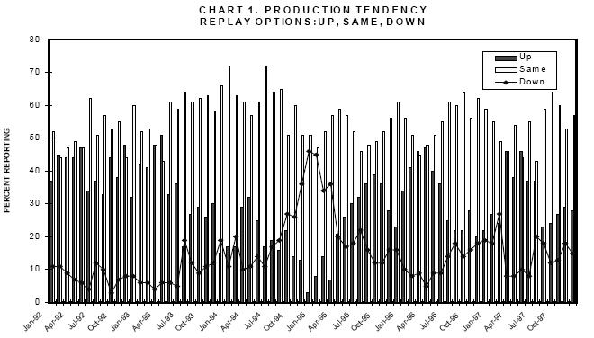
Data processing
Percentages for each reply option
From Business Tendency Surveys - A Handbook (OECD 2003)

Slide 32
Data processing - Balance statistics
For a 3 option answers, the balance is calculated as:
$$B=P−N$$
where
□ Above normal (P) □ Normal □ Below normal (N)
For a 5 option answers, the balance is calculated as:
$$B=\left(PP+\frac{1}{2}P\right)−\left(\frac{1}{2}N+NN\right)$$
where
□ A lot better (PP) □ A little better (P) □ Same □ A little worse (N) □ A lot worse (NN)

Slide 33
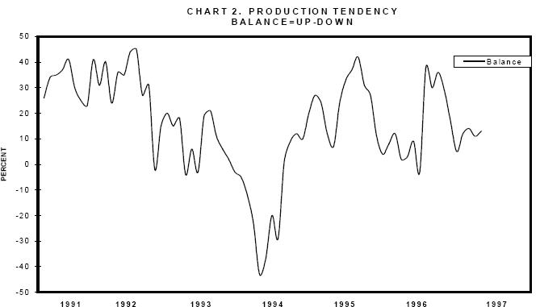
Data processing – Diffusion index
The Diffusion Index is calculated as:
$$DI=\frac{1}{2}\left(100−B\right)$$
From Business Tendency Surveys - A Handbook (OECD 2003)

Slide 34
Data processing – Other methods
Probabilistic methods
They assume a probability distribution of the opinion of the respondents
Regression methods
They assume that respondents implicitly attach a quantitative variable to each qualitative option
Latent factors models
They assume a latent variable behind each qualitative reply

Slide 35
Data processing
Choice of the quantification methods
Percentages
Balances
Diffusion index
Probabilistic methods
Regression methods
Latent factors models
For presentation of the results and calculation of composite indicators
For business cycle analyses and economic modelling

Slide 36
Metadata and Data Dissemination
It is important to provide metadata when disseminating the results of tendency surveys.
Methodology
Survey frame Size of frame list Characteristics Frame list update Population Sampling method Sample size Sampling error Response rate Treatment of non-responses Sample coverage Weighting scheme Kinds of economic activities Periodicity Survey method Fieldwork period Remarks methodology
Contact data
Country Survey Organization Official address Website Contact person
Data and dissemination
Type of data Unit of measure Data revision Frequency of dissemination Dissemination format Release policy
Metadata update

Slide 37
Metadata and Data Dissemination
Important considerations on data dissemination:
Release calendar
Confidentiality
Revision policy
Press release

Slide 38
Thank you
sna@un.org

