Slide 1

Objective of the session
Session 3.2
Going from derived variables to indicators on work in the informal economy
Producing informal employment indicators
Regional Course on Informality:
Definitions, Measurement, SDGs and Other Policy Indicators
16-20 October 2017, Chiba, Japan
F. Bonnet (bonnet@ilo.org)

Slide 2
Content
Objectives and focus of sessions 3.2 and 3.3
A set of internationally comparable indicators - a minimum set
First step: Indicators to estimate the extent of informality
Second step: Indicators to assess the composition of informal employment and identify groups most affected by informality
Group work
Next steps in session 3.3 ….

Slide 3
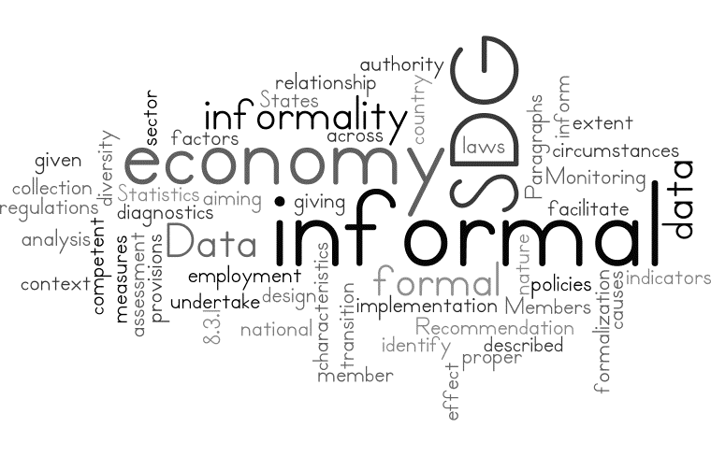
1. Objectives and focus of sessions 3.2 and 3.3

Slide 4

1. Scope & objectives of sessions 3.2 & 3.3
Focus
  Sessions 3.2 and 3.3 will focus on producing indicators on informal employment and employment in the informal sector derived from labour force surveys or similar household surveys.
  They will not cover the concept of informal work, the contribution of the informal sector to GDP or the specific analysis of economic units (see session 3.4)
Objectives
  Present some key indicators (internationally comparable) on the informal economy, including SDG 8.3.1 (session 3.2)
  Discuss the relevance of additional indicators to support the process of formalization at the national level (session 3.3)

Slide 5
1. Scope & objectives of sessions 3.2 & 3.3
Questions that will be covered
  Key indicators on the extent and composition of informal employment
    How many and who are those workers in the informal economy?
    Identify the categories of workers, enterprises or sectors warranting priority action?
    Identify whether informal employment occurs in informal sector economic units; in formal economic units or in households? With clear policy implications
  Additional indicators as part of national diagnoses of informality: to guide and then monitor the formalization process
    Assess some of the drivers of informality
    Working conditions in the informal economy and exposure to decent work deficits

Slide 6
1. Scope & objectives of sessions 3.2 & 3.3
What indicator for which purposes & users?
Session 3.2 | A set of internationally comparable indicators
What?
On the extent and composition of the informal economy
What for?
Contribute to the overall assessment of the labour market at the national level
SDGs monitoring and International comparisons
Dissemination (for instance)
National labour force survey report
Database available on the national website (and ILOStat database ;) )
Session 3.3 | Tailored to national specific needs
What?
For instance in the context of national diagnoses of informality
What for?
To understand the nature of informality for different groups of workers
To understand some of the root causes of informality
To assess the working conditions of workers in informal employment
Dissemination
Thematic report or study; important inputs to define priorities as part of national dialogue

Slide 7
1. Scope & objectives of sessions 3.2 & 3.3
What is an statistical indicator?
  A statistical indicator is the representation of statistical data for a specified time, place or any other relevant characteristic, corrected for at least one dimension (usually size) so as to allow for meaningful comparisons (over time, between countries, between groups within a country).
  It is a summary measure related to a key issue or phenomenon and derived from a series of observed facts. Indicators can be used to reveal relative positions or show positive or negative change.
  Important to inform policies and their implementation
    they assist in gathering ‘evidence’ for decision making
    should orient decisions on priorities
    Used to monitor and adjust policies when needed and
    are important for setting targets and monitoring their achievement (eg SDG).

Slide 8
2. A set of internationally comparable indicators
Overview of key indicators on the extent & first elements about composition

Slide 9
2. Key indicators
The starting point: Main derived variables
As part of labour force surveys
Persons employed in the informal sector
Enterprise based concept
+
Persons in informal employment in and outside the informal sector (formal sector and households)
Worker/job based concept
+
Demographic characteristics of workers such as: sex, age, level of education, urban/rural location, migration status, etc.
Employment related information: status in employment, occupation, economic activity, etc.
Beyond key indicators this allows the analysis of some of the factors of informality (e.g. education) and of specific groups such as:
Employees versus the self-employed
Domestic workers
The youth, etc.

Slide 10
2. Key indicators
The starting point: Main derived variables
 | Informal employment | Formal employment | Total
Total employment | A | B | C
Informal sector | D | E | F
Formal sector | G | H | I
Households | J | K | L
Employment in agriculture | M | N | O

Slide 11
2. Some key indicators of employment in the informal economy: some examples
SDG 8.3.1 indicator
Share of informal employment in non-agriculture employment, by sex
Informal employment as % of total employment
Informal non-agricultural employment as % of non-agricultural employment
Informal employment outside of the informal sector (formal sector and households) as % of total employment
(Informal*) employment in the informal sector as % of total employment
Share of informal employment among employees
Share of informal employment among entrepreneurs (own-account workers and employers)
Distribution of informal employment by status in employment (%) compared to the similar distribution of formal employment
Share of informal employment by economic sectors (ISIC)
Distribution of informal employment by main economic sectors (ISIC) compared to the distribution of formal employment
All to be disaggregated by sex, age groups, urban/rural residence, ...

Slide 12
2. Some key indicators of employment in the informal economy: some examples
Informal employment as % of total employment
Informal non-agricultural employment as % of non-agricultural employment
Informal employment outside of the informal sector (formal sector and households) as % of total employment
(Informal*) employment in the informal sector as % of total employment
Share of informal employment among employees
Share of informal employment among entrepreneurs (own-account workers and employers)
Distribution of informal employment by status in employment (%) compared to the similar distribution of formal employment
Share of informal employment by economic sectors (ISIC)
Distribution of informal employment by main economic sectors (ISIC) compared to the distribution of formal employment
Ind 1= A/C *100
Ind 2= (A-M)/(C-O) *100
Ind 3= F/C *100
Ind 4= (G+J)/C *100
Ind 5 & 6 = A/C *100 applied to statuses
Ind 7= distribution of A (&F) by emp. status
Ind 8= A/C *100 applied to ISIC
Ind 9= distribution of A (& F) by sectors

Slide 13
3. First:
Indicators to assess the extent of informality

Slide 14
2. Extent of informal employment
Question 1: What is the overall share of informal employment at the national level? What are the trends?
SDG 8.3.1 indicator
Share of informal employment in non-agriculture employment, by sex
Indicator 1 | Informal employment as % of total employment & Informal non-agricultural employment as % of non-agricultural employment
Numerator | Number of persons in informal employment Number of persons in non-agricultural informal employment
Denominator | Number of persons in employment (if we focus on employment) Number of persons in non-agricultural employment
Objective | Assess and monitor the overall incidence of informal employment or of non-agricultural employment in the country; allows for comparisons over time, between countries or between groups in a country
Limitations | A synthetic measure. If not complemented by additional indicators, does not really provide useful elements to understand the diversity of situations and needs in the informal economy.

Slide 15
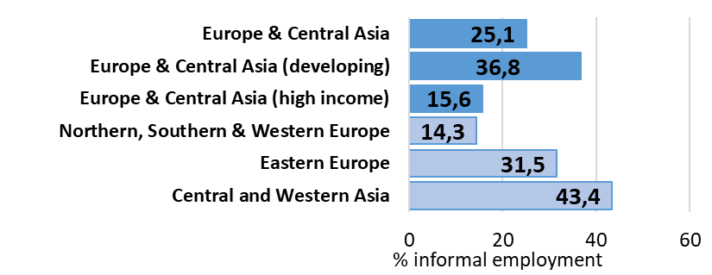
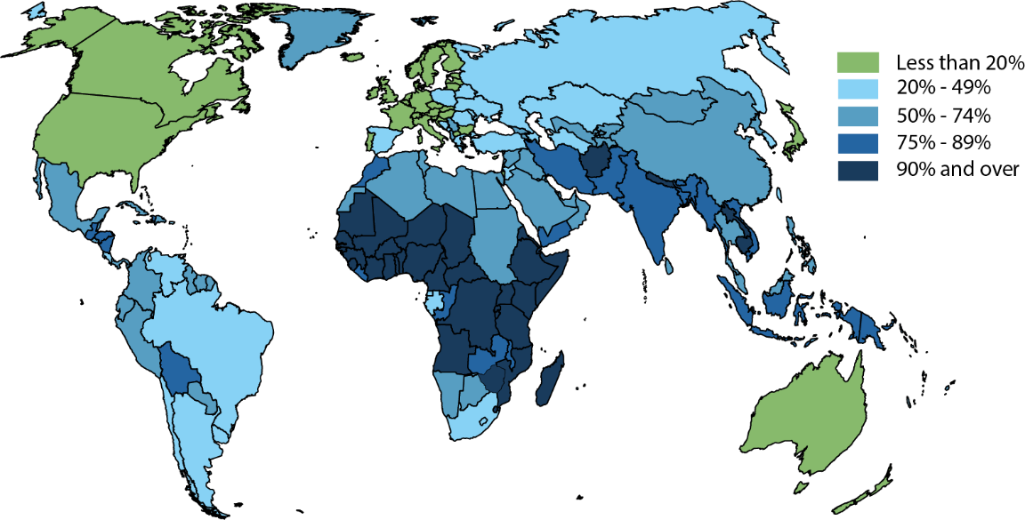
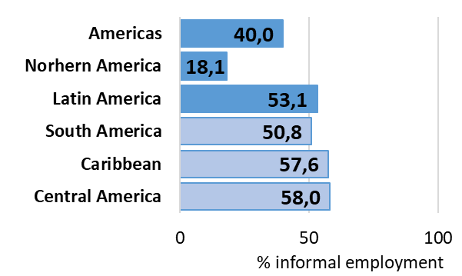
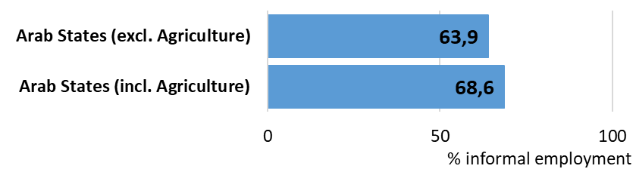
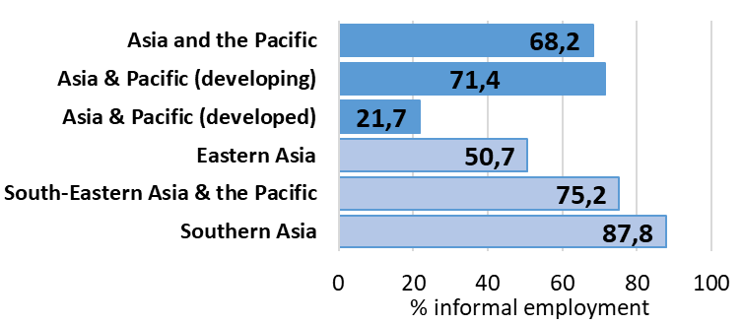
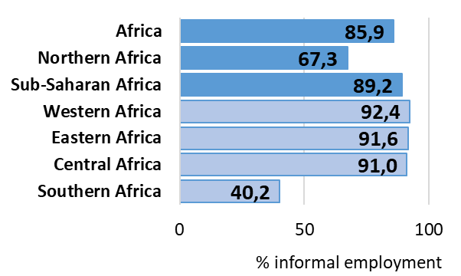
2. The magnitude of informality
% informal employment (estimates for 2016)
Indicator 1
Note: based on 118 countries representing 90 percent of global employment and estimated missing values. Estimates for 2016. Harmonized definition of informal employment (no registration or no complete set of accounts to define the informal sector and informal employment among own-account workers and employers; no social security gained through employment or, in case of missing, neither annual paid leave, nor paid sick leave to define informal employment among employees; all contributing family members are in informal employment). Limited number of countries for the Arab States, not displayed on this graph. Source: ILO calculations based on national household surveys

Slide 16
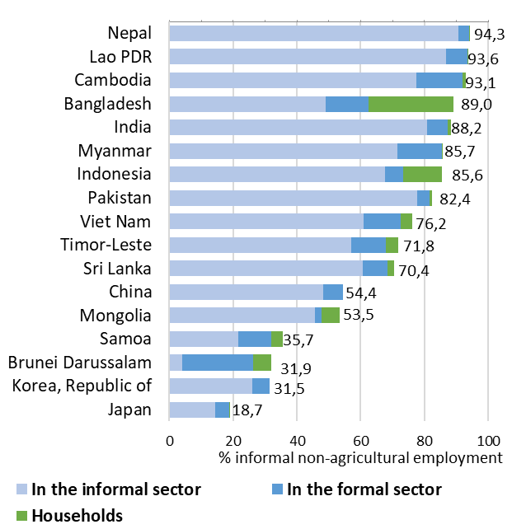
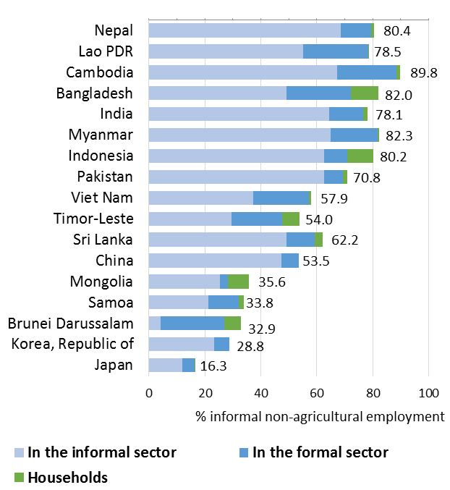
3. Extent of informal employment
Selected Asian countries (including & excluding agriculture)
Share of informal employment (including agriculture)
Share of informal employment (excluding agriculture)
Indicators 1 -4

Slide 17
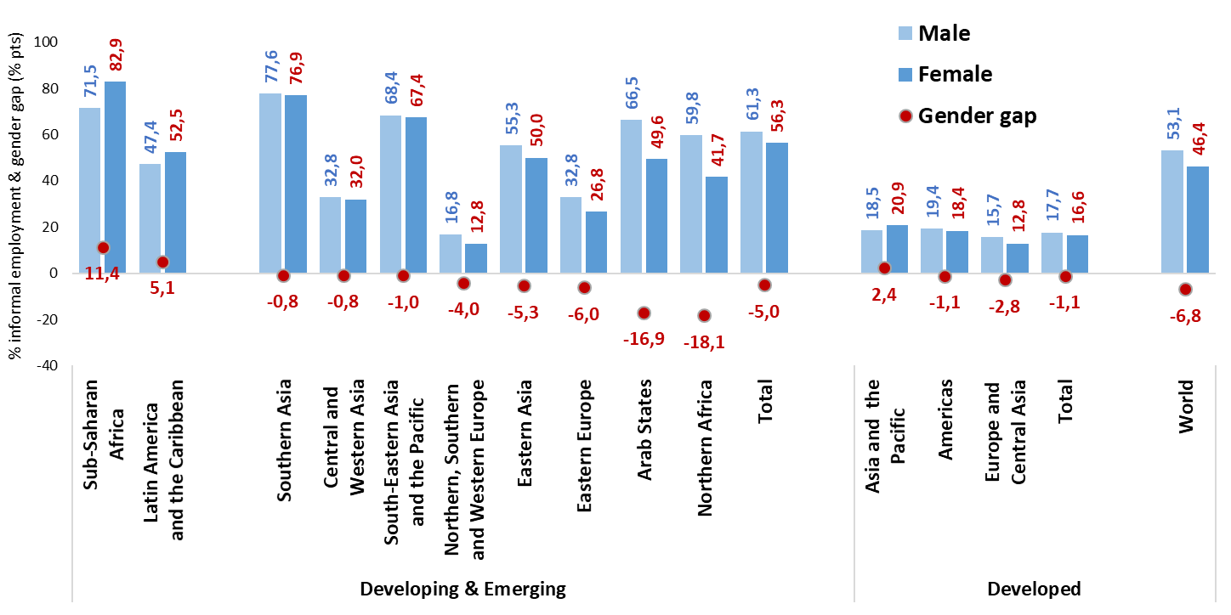
3. Extent of informal employment?
The gender dimension of informality (outside agriculture)
Women are more exposed than men in some regions but not globally.
Women are not more affected in numbers than men but when in the informal economy, they tend to be in the most vulnerable segments
The lower the participation of women in the labour market, the lower the share of informal employment in women employment (most extreme cases are North Africa and the Arab States)
Indicator 2 — SDG 8.3.1

Slide 18
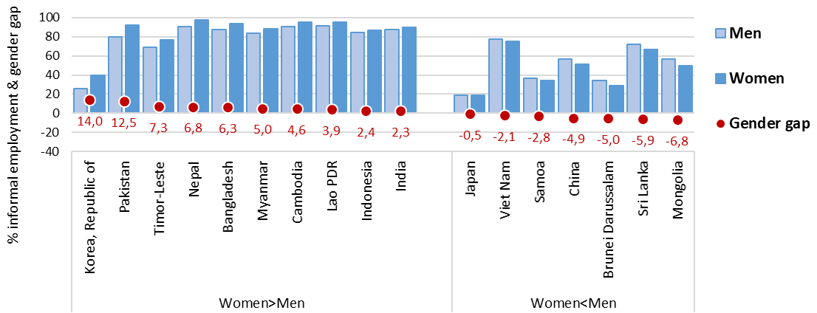
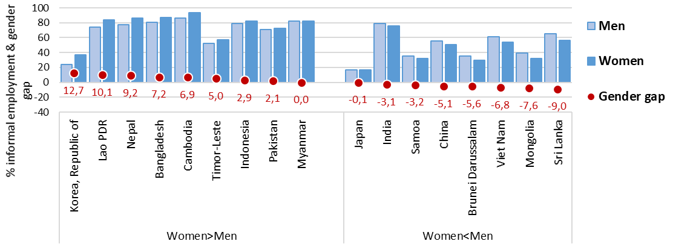
3. Extent of informal employment?
The gender dimension of informality in selected Asian countries
Including agriculture
Excluding agriculture
SDG 8.3.1

Slide 19
4. Second: indicators about the composition & some first elements for policies

Slide 20
4. The composition of informal employment
Once you know about the “size” of informal employment => important to know about the composition
In formal sector enterprises
In informal sector enterprises
Formalization of jobs:
Mainly an issue of protections: ie an effective access to social security and to other employment related benefits. Being registered or declared can be necessary but not enough.
Employment status concerned
Employees
  Formalization of jobs
Contributing family workers
  Shift to employees
Concerns all statuses in employment
Employees
  Measures: Formalization of jobs & formalization of enterprises
Employers
  Measures: Formalization of enterprises (+ jobs for their employees)
Own-account workers:
  Measures: Formalization of enterprises
Contributing family workers:
  Measures: try to shift their status to employees & Formalization of enterprises
Structural factors of influence
Tends to increase with levels of development & the increase in the share of wage workers in total employment
Formalization of enterprises:
How to lower the costs of registration and of remaining formal & how to increase the benefits of the formalization of economic units (access to social security, access to markets, financial resources, etc.)
+ measures to tackle the root causes of informality including to increase productivity
In households
Informal employment
Employment status concerned
Employees (domestic workers)
  Formalization of jobs
Independent workers producing for own-use
  Is it a formalization issue?
Structural factors of influence
The lower the share of employees in total employment, the higher the share of informal employment in informal sector enterprises
Represents most of informal employment in low and lower-middle income countries

Slide 21
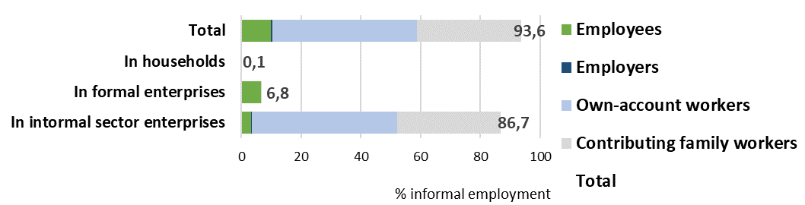
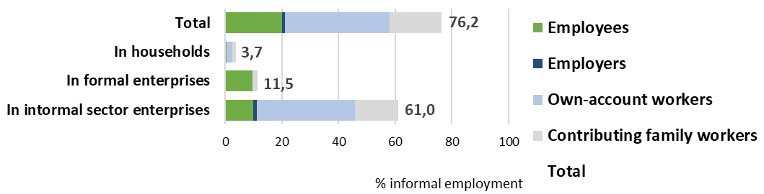
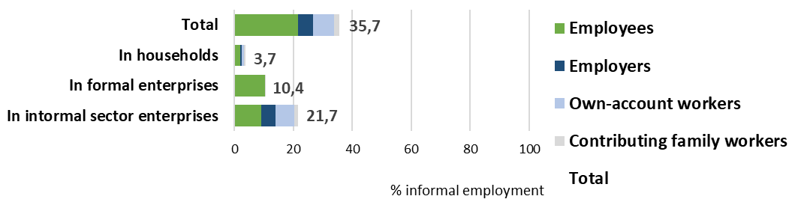
4. The composition of informal employment
Examples from selected Asian countries
Lao PDR
Viet Nam
Samoa

Slide 22
4. Workers most exposed to informal employment
Question 3a: Who are the workers the most exposed to informality? Identify the categories of workers, enterprises or sectors warranting priority action
Workers more likely to be in informal employment
Indicators:
Share of informal employment among different groups, depending on:
Share of informal employment among:
Socio-demographic features: sex, age, rural/ urban location, level of education, size of household, marital status; etc.
Women / men
The youth compared to adults or senior workers
In rural versus urban areas
Employment related features: employment status; occupations; sectors
Employees versus own-account workers and employers
In agriculture; construction and other sectors
Among domestic workers

Slide 23
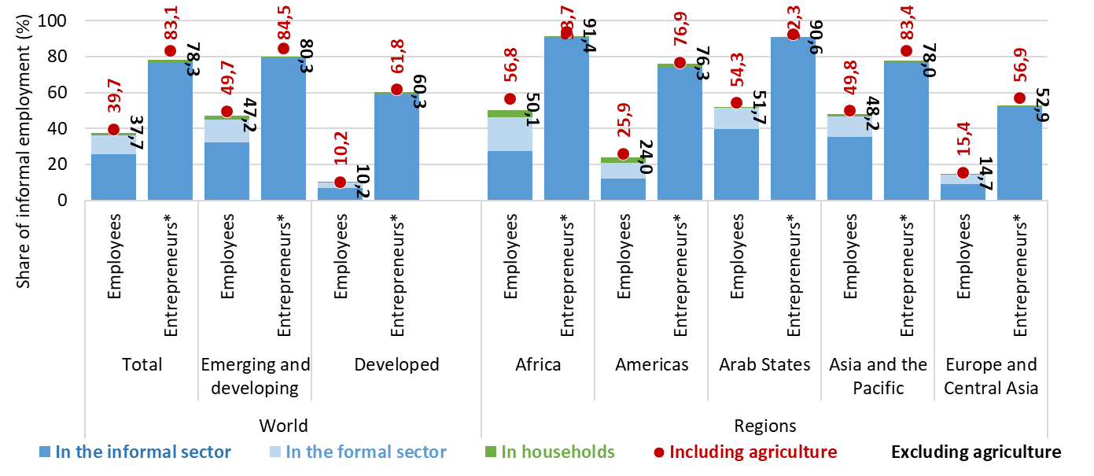
4. Workers most exposed to informal employment?
% informal employment for employees & entrepreneurs?
% informal employment by employment status
Common trends: Independent workers are the most affected by informality
Implications The structure of the labour market by status will influence the overall share of informal employment as well as the relative share of informal employment in or outside formal sector enterprises with implications in terms of the set of policy responses to be developed
Indicators 5-6

Slide 24
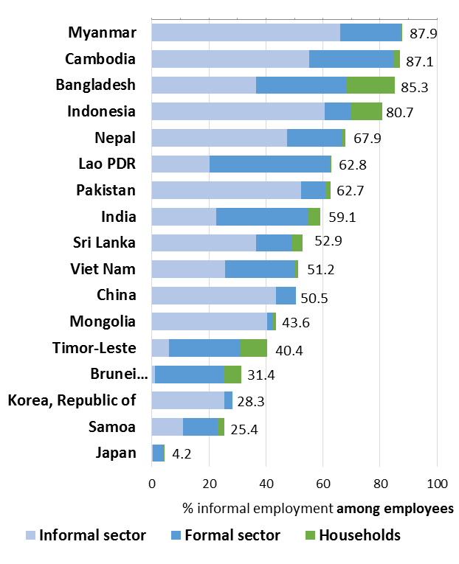
4. Workers most exposed to informal employment?
Informal employment among employees: primarily an issue of formalization of jobs?
Share of informal employment (including agriculture) among employees
Those are the proportions of employees in informal employment
In informal sector enterprises
In formal sector enterprises
In households
Q1 - Can you identify 3 countries where it seems that informality among employees is primarily an issue of formalization of jobs?
i.e. informal employment in formal sector enterprises
Q2 – What does this mean in terms of policy objectives? (link with criteria used to measure informal employment)

Slide 25
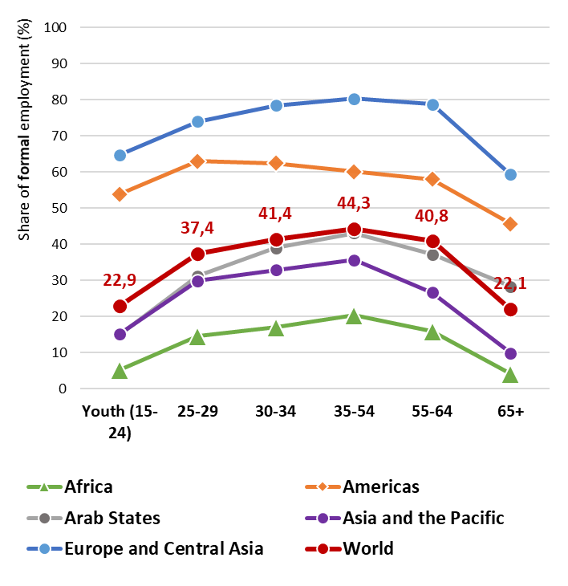
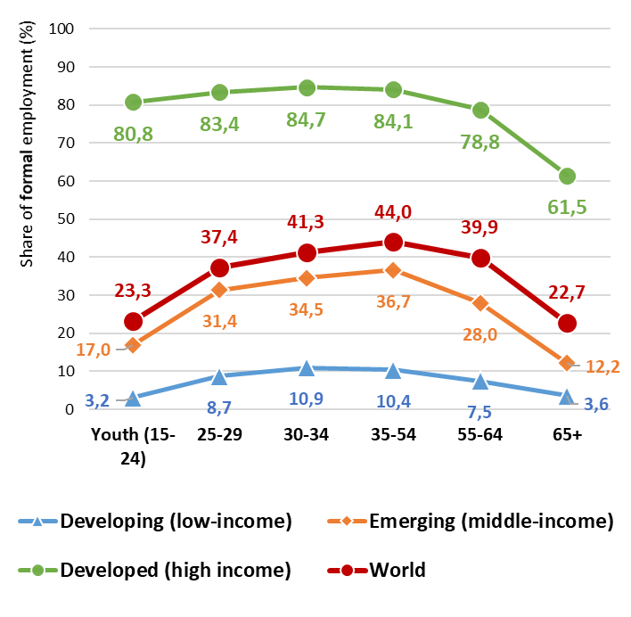
4. Workers most likely to be in formal employment?
The age profile of fomality
% formal employment and age
Common trends: Inverse U curve with age: youth and older workers more affected by informality than others
Differences : Main regional differences concern low-income countries and a widespread informality at all ages & high income countries with youth relatively less affected than in other regions
Source: ILO based on household surveys.
Note: Global estimates based on 108 countries representing more than 85 per cent of total employment. Harmonized definition of informal employment.

Slide 26
4. Composition of informal employment?
Answering to the question: Among workers in informal employment, who are those representing the majority?
Question 3b: Composition of informal employment? What groups are the most represented among workers in informal employment?
Composition of informal employment compared to formal employment
Distribution of workers in informal employment (compared to those in formal employment) by
Among those in informal employment, what is the proportion of:
Socio-demographic features: sex, age, rural/ urban location, level of education, size of household, marital status; etc.
Women / men
youth, adults or senior workers
Rural, urban
Employment related features: employment status; occupations; sectors
Employees versus own-account workers and employers
Workers in agriculture; construction and other sectors

Slide 27
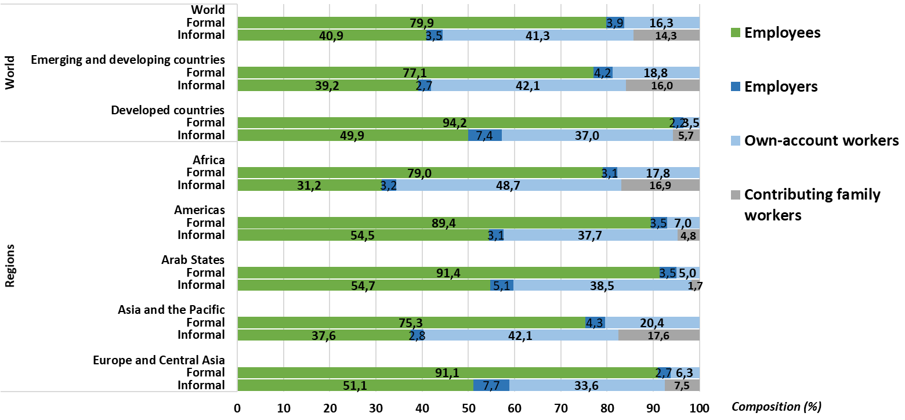
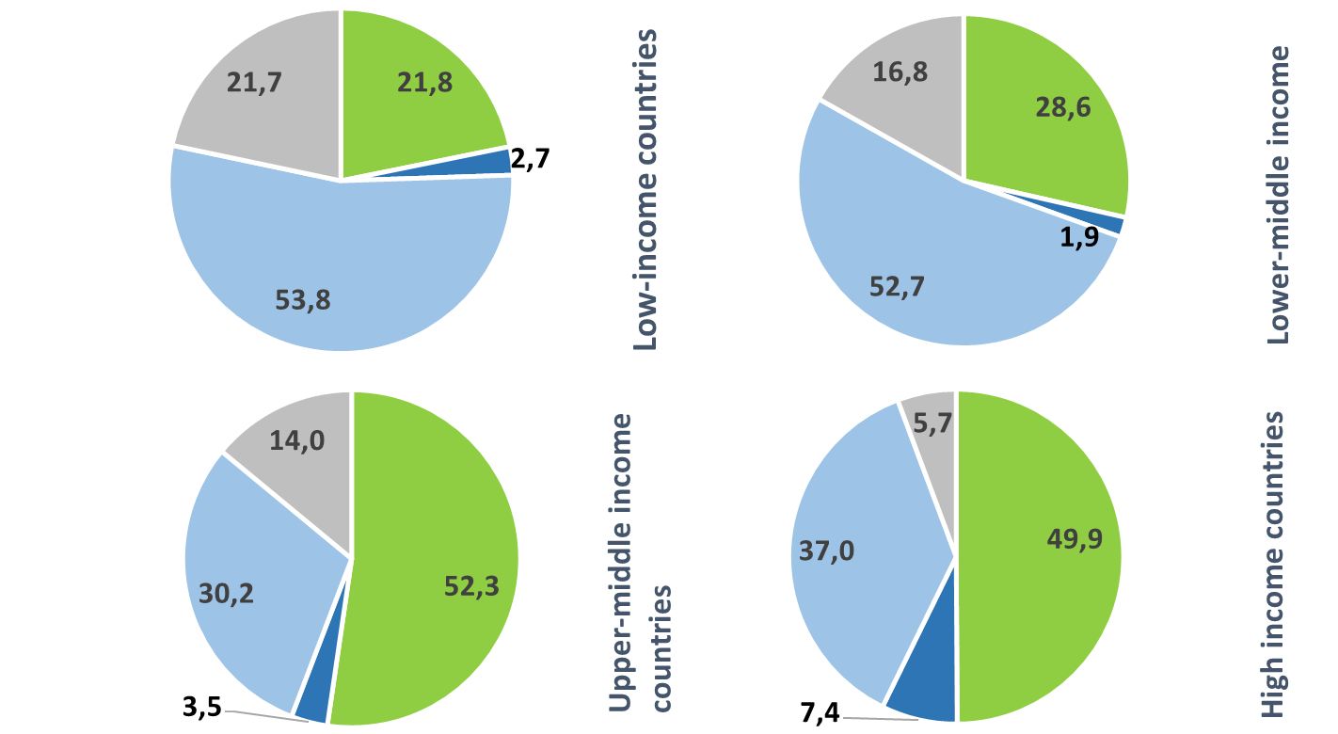
4. Composition of informal employment?
Composition of informal & formal employment by employment status
Distribution of informal employment by status in employment
The self employed represent 60% of those in informal employment and this this share increase with the decrease in the level of development (non-wage workers represent nearly 80% of informally employed people in low-income countries)
Still, employees represent 41% of total informal employment worldwide and more than half in Europe & Central Asia
Common trends between regions but differences depending on employment statuses
Indicator 7

Slide 28
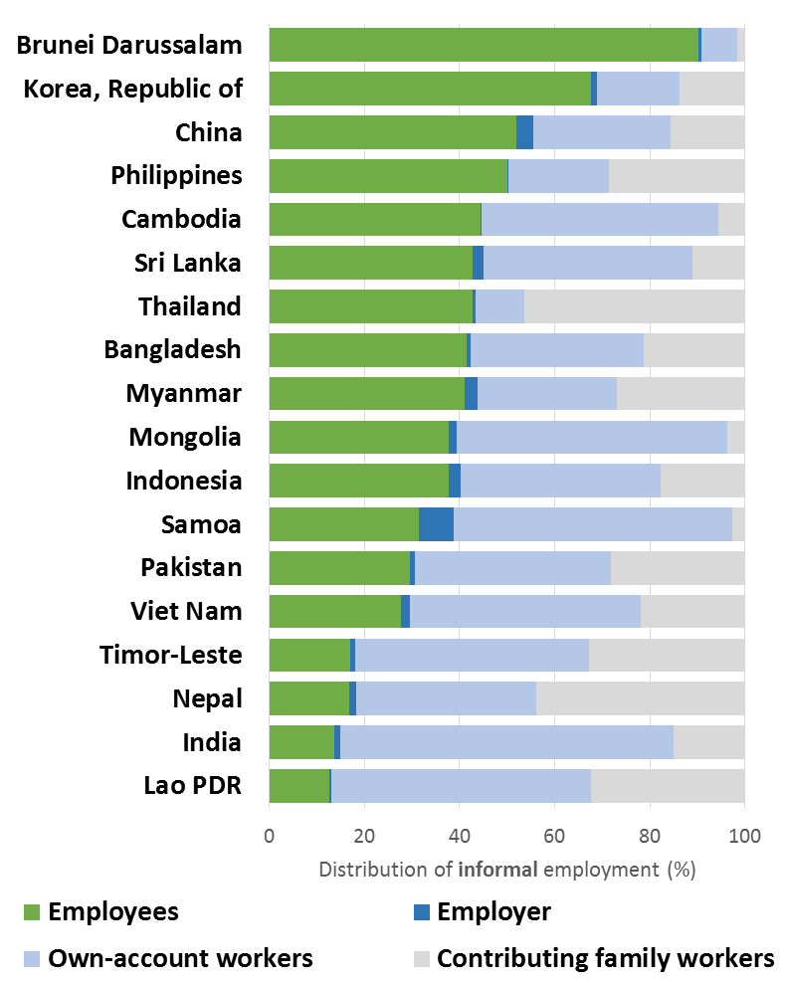
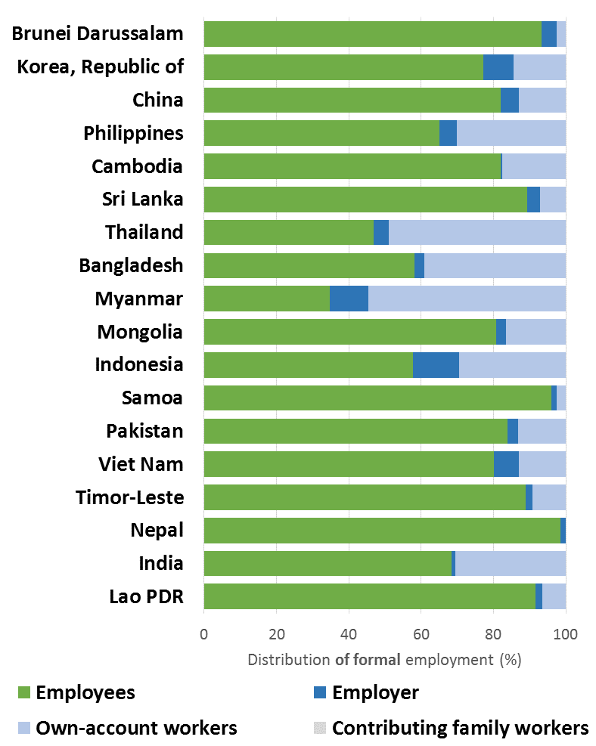
4. Composition of informal employment?
Composition of informal & formal employment by employment status in selected Asian Countries
Distribution of informal employment by employment status
Distribution of formal employment by employment status
What can we say about:
Employment status and informality?
Employment status and formality?
The incidence of labour market structure?

Slide 29
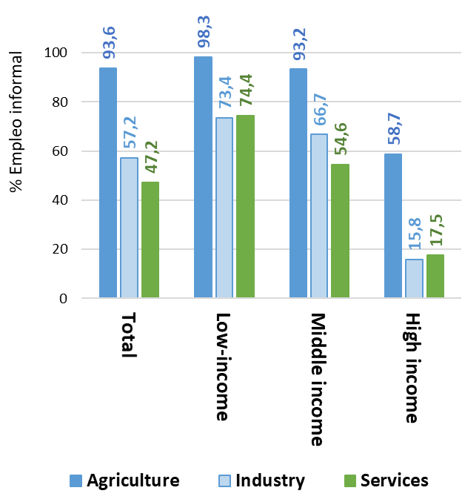
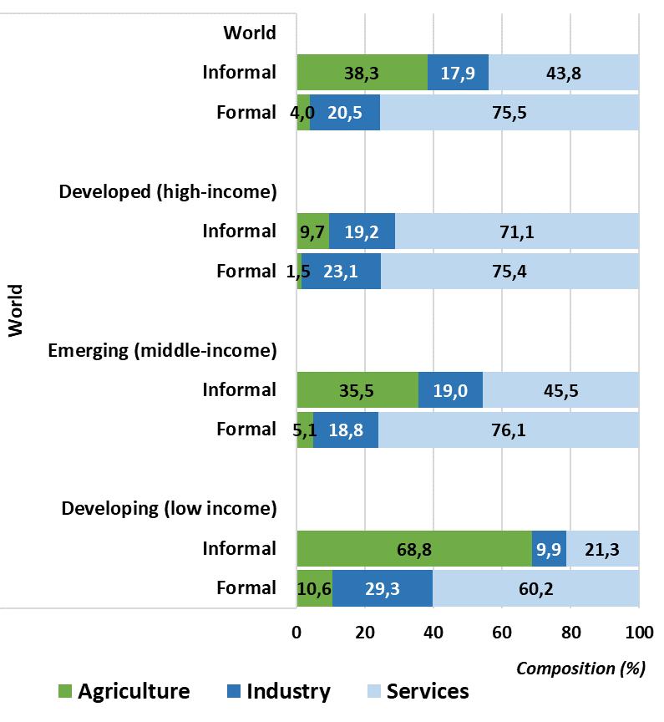
4. Composition of informal employment?
The sectoral dimension: % informal employment by sector
% informal employment by sector
Common trends: Workers in agriculture are more exposed than others in all regions
Still, in “numbers’, workers in services represent the majority of the informally employed worldwide
The share of services in total informal employment tends to increase with the income in the level of income in countries
Indicators 8 & 9

Slide 30
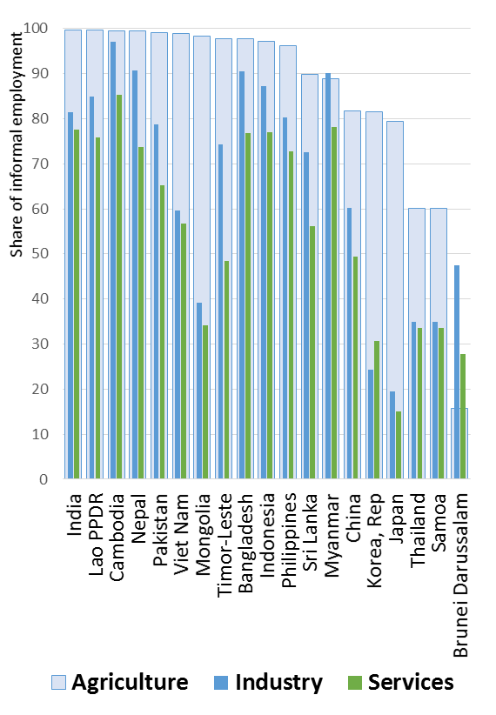
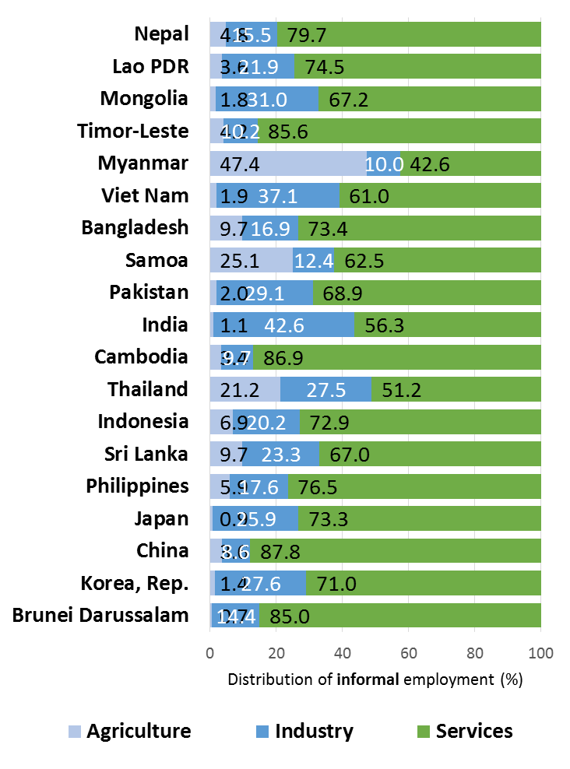
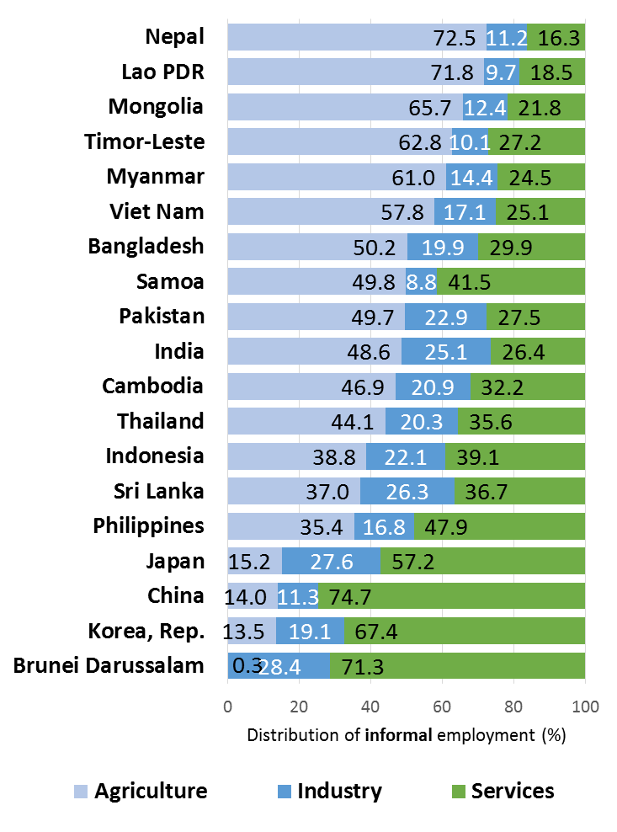
4. Composition of informal employment?
The sectoral dimension in selected Asian countries
Distribution of informal employment by employment status
Distribution of formal employment by employment status
Share of informal employment by main sector in selected countries in Asia
Distribution of informal employment by sectors:
In what sector do we find most people in IE?
Indicators 8 & 9

Slide 31
5. Group work

Slide 32
5. Group work (1)
Let’s assess and discuss the extent and composition of informal employment in your countries
Open the excel file called ‘Session 3.2 Group work’
2 data sheets
  Session 3.2 Data ALL
  Session 3.2 Data Excl AGRI
The 2 data sheets present the same structure
For each country (column B), you can find the number of persons — Total and by employment status (Column C) — in
  Informal employment (columns D-G)
    Total (D); in the informal sector (E); in the formal sector (F); in Households (G)
  Formal employment (Columns I-L)
  Total employment (Columns N-Q)
The remaining columns correspond to the same set of data but respectively for
  Men (columns S-AF)
  Women (columns AH-AU)

Slide 33
5. Group work (2)
Let’s assess and discuss the extent and composition of informal employment in your countries
Using data on the number of persons In informal employment, in the informal sector, in the formal sector, in households:
Question 1
  Can you estimate for your country or another one (if your country is missing)
    Indicator 1. The share of informal employment in total employment
    Indicator 2. SDG 8.3.1 The share of non-agricultural informal employment by sex
Question 2
  Can you estimate informality rates by status in employment (including agriculture)
    Indicator 3. Share of informal employment among employees
    Indicator 4. Share of informal employment among employers
    Indicator 5. Share of informal employment among own-account workers

Slide 34
5. Group work (3)
Question 3: distribution by employment status
  Can you estimate
    The distribution of informal employment by employment status
    The distribution of formal employment by employment status
  Question 4: Where do informal employment occurs?
  Estimate the proportions (as a percentage of total employment) of
    Persons in informal employment in informal sector enterprises
      Total
      Employees
      Employers
      Own-account workers
      Contributing family workers
    Persons in informal employment in formal sector
    enterprises
      Total
      Employees
      Contributing family workers
    Persons in informal employment in households
      Total; Employees; Employers; Own-account workers;
      and Contributing family workers
Discussion of results
Typical examples of workers in those different categories
Objectives and examples of measures to facilitate the transition to formality (including reduction of decent work deficits)

Slide 35
5. Group work (4)
Question 4
Indicate the numbers that apply for your country and calculate the proportions (expressed as a percentage of total employment)
In formal sector enterprises
In informal sector enterprises
Employees: _________ nb _________ %
Employees: _________ nb _________ %
Contributing family
Workers: _________ nb _________ %
Employers: _________ nb _________ %
Own-account
workers: _________ nb _________ %
Total: _________ nb _________ %
Informal employment (including agriculture)
In households
Contributing family
Workers : _________ nb _________ %
Employees: _________ nb _________ %
Non-
employees: _________ nb _________ %
Total: _________ nb _________ %
Total: _________ nb _________ %

Slide 36
Thank you

