Slide 1
MEDSTAT Regional Workshop on Statistics of Informal Work Paris, 10-12 July 2017
Data sources for producing statistics on the informal economy Household surveys
ILO: Michael Frosch
frosch@ilo.org

Slide 2
Different countries different solutions
No one solution fits all
Great degree of flexibility within the conceptual framework
Needs to be adapted to national context
Labour legislation
Social protection system
Needs to be integrated in the structure of the questionnaire
....but still ensure the international definitions and concepts

Slide 3
Household surveys with labour force modules: obvious candidates for informal employment
LFS is usually the survey with the biggest sample size, it covers:
All the active population
All economic sectors and occupations
All type of jobs (or economic activities)
is very often conducted on quarterly bases
To capture seasonality … ( very important for informal jobs)
collects relevant labour market information on all the HH members
Seasonal, casual and secondary jobs, as well as hours worked and payments etc.)
Gives the possibility to conduct detailed and complex socioeconomic analysis of informality

Slide 4
Household surveys with labour force modules: obvious candidates for informal employment
The focus is typically on:
Informal employment
Employees/Contributing family workers in informal employment
Entrepreneurs in the informal sector
Employment in informal sector
Less suitable to collect information about economic units in the informal sector
Type of production, value added (input to SNA)

Slide 5
Household surveys with labour force modules: sampling issues
Informal employment/sector is generally concentrated
In specific economic sectors
In specific geographical areas
The sample should include a sufficient number of households
With informal sector entrepreneurs
With members in informal employment,
which allow good estimations of different type of informal activities

Slide 6
Four topics needs to be addressed in the questionnaire
Household production of goods (exclusively/mainly) for own final use
Informal sector
Status in employment
Informal employment

Slide 7
Four topics needs to be addressed in the questionnaire
Household production of goods (exclusively/mainly) for own final use
Informal sector
Status in employment
Informal employment

Slide 8
Own-use production
Relevant in countries with a significant share of own-use production
13´th ICLS resolution; Households producing goods exclusively for own final use informal employment, the production unit is defined as a household
19´th ICLS resolution; Need to identify own use production work producing goods in order to complement informal employment

Slide 9
Example Bulgaria 13´th ICLS
Market production
Production exclusively for own final use
Per definition in informal employment in ”household sector”

Slide 10
Based on Guyana 19´th ICLS
Employed
Own use production work with market production
Production exclusively for own final use
Per definition in informal work in ”household sector”

Slide 11
Four topics needs to be addressed in the questionnaire
Household production of goods (exclusively/mainly) for own final use
Informal sector
Status in employment
Informal employment

Slide 12
Informal sector
For the purpose of informal employment it is sufficient to collect informal sector for:
Employers
Own-account workers
Members of producers cooperatives
But informal sector is an important analytical variable for employees and contributing family workers and for measuring e.g. employment in the informal sector
But might be difficult to collect

Slide 13
Key questions to measure the informal sector
Legal organization (institutional sector)/ ownership
Government, NGO, public enterprise, privately owned enterprise
Incorporated/Unincorporated
Is the enterprise incorporated or not
Bookkeeping
Keeps complete accounts/does not keep complete accounts
Registration of enterprise
Under specific forms of national legislation (question needs to specify the registration type)
Identifies unregistered enterprises

Slide 14
Model flow chart
Marked production
No
Yes
Q1. Institutional sector
6. Private household
1,4,5
Gov, NGO, IO etc
2. Farm
3. Private business
7,8. Other, DK
Q3. Incorporated/Unincorporated
1. Incorporated
2. Unincorporated
3.Don’t know
Q4. Bookkeeping
Works in households
1,2,3. Completeaccounts
4. Does not keep accounts
5.Don’t know
Q5. Registration
=2 registered at national level
=1 not registered at national level
3 Other
Unclassifiable !!!
Works in the informal sector
Works in the formal sector

Slide 15
Unclassifiable

Slide 16
Flow chart II
Institutional sector
Government, Corporations, NGO, IO etc
Private household
Farm or private business (unincorporated)
Other, DK, NA, Not asked
Bookkeeping
Keeps accounts for reporting to the Government
Does not keep accounts
Other, DK, NA, Not asked
Registration
Registered at national level
Not registered at national level
Other, DK, NA, Not asked
Households (producing exclusively for own final use)
Status in employment
Employees
Other
Social security contribution
Yes
No
Place of work
Other
Non-fixed premises
Q6. Size
6 or more, other
5 or less
Formal sector
Informal sector

Slide 17
Example based on Kosovo LFS
Institutional sector
Identifies incorporated enterprises
Q1, and especially Q2 needs to be adapted to national context

Slide 18
Example Kosovo II
Registration
Quasi corporations
Q3, and Q4 needs to be adapted to national context

Slide 19
Countries are using different criterias (South Africa)
4.5. Status in Employment
2. Employers; 3. own-account; 4. working unpaid in household business
1. Employees
4.13. Registered for VAT or income tax
4.10. Income tax deducted by employer
2. No
2. No
4.16. Size of establishment: fewer than 5 employees?
1. Yes
Informal sector

Slide 20
Countries are using different criterias (II)
Tanzania
Type of ownership
Size
Ecuador
Size
Type of account
Registration
Moldova
Institutional sector/type of ownership
Registration
and so on.....

Slide 21
Four topics needs to be addressed in the questionnaire
Household production of goods (exclusively/mainly) for own final use
Informal sector
Status in employment
Informal employment

Slide 22
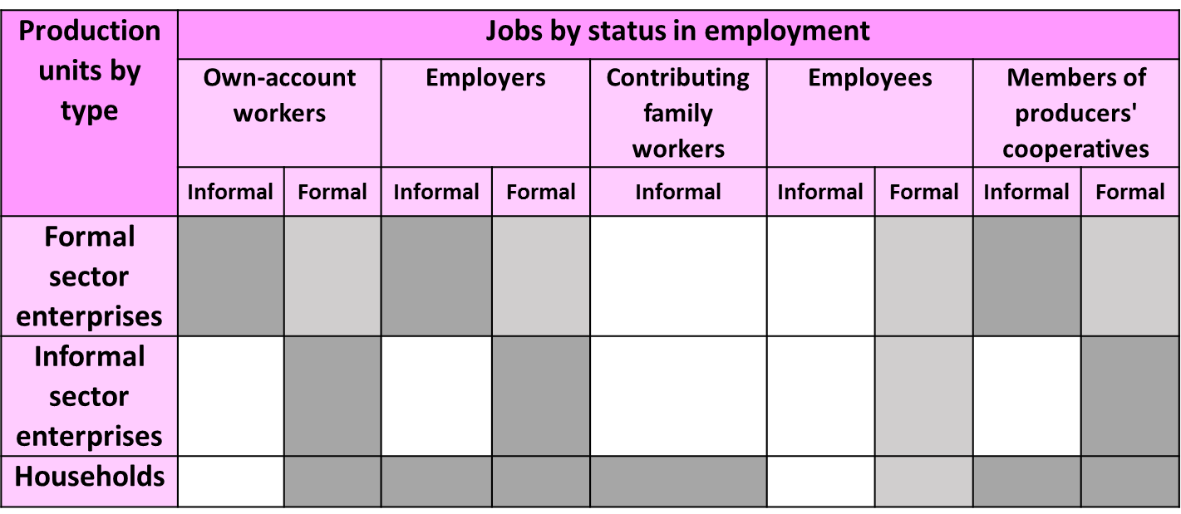
ICSE-93
ICSE-93 is a key to define informal employment
Own-account workers, employers and MPC are defined on the basis of the characteristics of the production unit
Contributing family workers and employees are defined on the basis of the characteristics of the job

Slide 23
Status in employment

Slide 24
Four topics needs to be addressed in the questionnaire
Household production of goods (exclusively/mainly) for own final use
Informal sector
Status in employment
Informal employment

Slide 25
Use status in employment as a starting point
If status in employment is Employer or Own-account worker and the economic unit is within the informal sector
Informal employment
Contributing family worker Informal employment

Slide 26
Operationalization of informal employees
Following the ILO Definition there are 5 potential criteria to distinguish formal from informal employees:
Tax deduction from the salary
Other benefits (maternity/paternity leave etc.)
Affiliation to social protection scheme
Entitlement to paid sick leave
Entitlement to annual leave
The 17th ICLS, allows countries to use different criteria depending on national circumstances

Slide 27
Informal employees Data availability
Overview of questions in Labour Force Surveys that could be used to measure informal employees
 |  | Africa | Americas | Arab States | Asia and the pacific | Eastern Europe | Western Europe | OECD | All
 | taxes are paid? | 10 | 3 | 0 | 2 | 0 | 1 | 1 | 16
social contributions are paid? |  | 10 | 19 | 3 | 13 | 8 | 3 | 5 | 56
 | paid annual vacation? | 19 | 13 | 2 | 14 | 5 | 2 | 4 | 55
 | paid sick leave? | 12 | 11 | 1 | 10 | 5 | 0 | 2 | 39
 | paid maternity leave? | 7 | 4 | 1 | 6 | 0 | 3 | 5 | 21
 | No relevant question | 9 | 8 | 3 | 15 | 15 | 15 | 24 | 65
 | Total available questionnaires | 35 | 29 | 7 | 32 | 23 | 22 | 35 | 148

Slide 28
Guyana LFS
Needs to be adapted to national context, and exemplify the question with one relevant example

Slide 29
Informal employees
Three different approaches to derive formality
Strict approach
All criteria of formality have to apply to be classified as formal employee
Produces potentially less formal employees
Weak approach
At least one of the criteria of formality has to apply to be classified as formal employee
Produces potentially more formal employees
Moderate approach
One criteria of formality have to apply or two of the criteria to be classified as formal employee
Produces typically an in between situation
vs
vs

Slide 30
Strict formality approach
Status in employment
Employees,
Contributing family workers
Own account workers
Employers
Job-related employer contributions to social security
No, DK, NA
yes
Benefit from paid annual leave
No, DK, NA
yes
Benefit from paid sick leave
No, DK, NA
yes
Formal employment
Informal employment

Slide 31
Weak formality approach
Status in employment
Employees,
Contributing family workers
Own account workers
Employers
Job-related employer contributions to social security
yes
No, DK, NA
Benefit from paid annual leave
yes
No, DK, NA
Benefit from paid sick leave
yes
No, DK, NA
Informal employment
Formal employment

Slide 32
Moderate approach
Status in employment
Contributing family workers
Own account workers
Employers
yes
Job-related employer contributions to social security
No
DK, NA
Benefit from paid annual leave
No, DK, NA
yes
Benefit from paid sick leave
No, DK, NA
yes
Formal employment
Informal employment

Slide 33
Different outputs
 | Strict formality approach |  | Weak formality approach
 | Formal employees | Informal employees | Formal employees | Informal employees
Moldova | 87.5 | 12.7 | 90.5 | 9.7
Costa Rica | 65 | 35 | 81 | 19
México | 45.7 | 54.3 | 66.4 | 33.6
Malawi | 14 | 86 | 27 | 73
Cambodia | 2.7 | 97.3 | 20.5 | 79.5
Difference between weak and strict (OR/AND)
Moldova | 3
Costa Rica | 16
México | 20.7
Malawi | 13
Cambodia | 17.8

Slide 34
Practical recommendation on the use of these approaches
If a country do have a well-established social security system that is attached to the job
then contribution to social security is the main criterion
and the moderate approach should be viewed as an international definition trying to achieve simplicity
For countries were this is not the case (e.g. due to non-existing social security system or a universal system)
then the 2 other criteria's can be used instead.
Countries should always collect the three key questions (criteria's) for all the employees
assess how the three key criteria are correlated
chose the approach taking the national context into account
In the moderate approach the information regarding paid sick leave and paid annual leave still would be very relevant to contextualize informality.

Slide 35
Essential step: test it!!

Slide 36
Important because
To ensure that respondents really understand the questions and are willing and able to answer them in a valid way
To ensure that we measure what we want to measure
To detect problems errors early in the process –Cost effective
Increases the quality

Slide 37
Thank you

