Slide 1
Regional course on Informality Chiba, 16-20 October 2017
Statistical definitions of informal economy Informal employment
ILO: Michael Frosch
frosch@ilo.org

Slide 2
Informal employment
17´th ICLS Guidelines concerning a statistical definition of informal employment
Endorsed by the 17th ICLS, 2003
Complements the 15´th ICLS resolution concerning statistics of employment in the informal sector
Expands the scope of informality beyond the informal sector
Informal sector
Informal employment

Slide 3
Towards an statistical definition
Definition of informal employment
“Informal employment comprises the total number of informal jobs”
Not a conceptual definition
Defined by its components

Slide 4
Three essential components
The concept of informal job has three essential components
Characteristic of the work relationship
Employment
Based on the 13´th ICLS definition but now replaced with the 19´th ICLS
The definition of ”Informal”
Structured around the International Classification of Status in Employment (ICSE-93)

Slide 5
Characteristic of the work relationship
Job based concept
A person can have one or more informal and/or formal jobs
A person is in informal employment if at least one of the jobs are informal
However; SDG 8.3.1 informal employment is defined as informal employment in main job
Can be carried out in any kind of production unit
Formal sector unit
Informal sector unit
Household unit

Slide 6
FORMAL SECTOR
INFORMAL SECTOR
INFORMAL EMPLOYMENT
HOUSEHOLD UNITS

Slide 7
Employment
Employment as previous defined in the 13´th ICLS resolution includes
Persons that work in exchange of a remuneration
Own use producers of goods
Conceptually; Unpaid work (unpaid trainees, volunteers, etc.)
With the 19´th ICLS this is now regarded as different forms of work

Slide 8
Definition of informal employment and ICSE-93
Whether a job is informal or not depends on the characteristics of the work relationship
Employers, Own-account workers and Members of producers cooperatives; relies on the characteristics of the production unit
no clear separation between the production unit and the job in informal sector units
Employees and contributing family workers; relies on the characteristics of the job
have an employment relationship that can be characterised as either formal or informal independently on the production unit

Slide 9
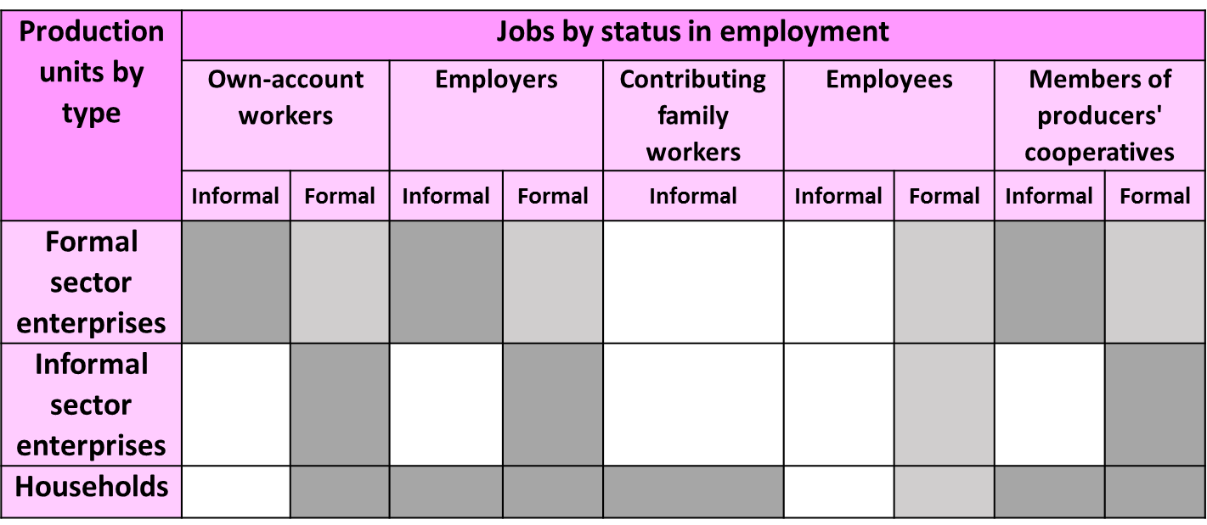
ICSE-93
Contributing family workers and employees are defined on the basis of the characteristics of the job
Employees can have informal or formal jobs in all types of production units
Own-account workers, employers and MPC are defined on the basis of the characteristics of the production unit
If the production unit is an informal sector unit then the job is defined as informal
Contributing family workers have per definition an informal job
Own use production of goods exclusively for own final use is per definition an informal job

Slide 10
Definition of an informal job
Employers,
Own account workers,
and MPC
Contributing
family workers
Employees
The economic
unit is informal
or a household
ALL
?

Slide 11
17´th ICLS guidelines
Employees are considered to have informal jobs if their employment relationship is not subject, in law or in practice to
national labour legislation
income taxation
social protection
entitlement to certain benefits (advance notice of dismissal, severance pay, paid annual or sick leave, etc.)

Slide 12
Informal employees: Not subject to national labour legislation
National labour legislation regulates the right to
A decent (minimum) wage
Regulated hours of work
Weekly rest
Organize and negotiate
Annual leave
Sick leave (paid or unpaid)
Protection against abusive dismissal
Severance pay
Etc.
Existence of a written contract is often used to identify employees who are subject to national labour legislation.
But it is not necessarily a good proxy.
Beware!

Slide 13
Informal employees: Not subject to income taxation
We can be sure that if the employer deduct income tax, the job is formal
They are reporting to the government
But if the employee does not declare earnings of the job, it may be because it is not required by national law
For example, because tax is deducted directly only from earnings as of a certain amount
We cannot be certain that the job is informal
This criterion might be useful to exclude evident cases of formal jobs, but not to identify informal jobs directly!

Slide 14
Informal employees: Not subject to social protection
Social protection provides social benefits to the population
Old age, sickness, maternity, unemployment, accidents, etc.
Usually, a fixed share is deducted from earnings from each job (social insurance)
If contributions are deducted from earnings, they are formal
But there might be cases when the criteria is less meaningful:
Universal system (Not related to the job)
The social protection system is to basic within the country
There are no programs available for all types of employees (Only government employees are covered)
Even for employees covered, services are too basic and they cannot really benefit from them

Slide 15
Informal employees: Not subject to certain employment benefits
Benefits mentioned in the standards
Advance notice of dismissal
Severance pay
Access to paid annual leave
or compensation for it
Access to paid sick leave
These two criteria are the most commonly used as a complement to social protection
It is better to identify whether the employee is actually able to enjoy these rights than whether they theoretically have the right to do so

Slide 16
Other possible criteria*
Written contract
Only if it implies labour legislation coverage. But beware that may not be relevant if employees may not actually enjoy benefits/protection by labour legislation
May not be relevant if even government employees do not have a written contract
Casual/temporary nature of job
Useful when labour legislation does not cover employees in these situations
But beware that there may be employees in permanent jobs that may also be informal
Low working hours or low wages
Useful when workers in these situations are not expected to contribute to social security systems, to pay taxes or to enjoy any work benefits
* These criteria cannot be used to define the informal employment but may be used when information on main criteria is not available

Slide 17
Informal employees
The relevance of the criteria's needs to be evaluated within the context of the specific country
Type of social protection system
Universal/job-dependent?
Voluntarily/obligatory
Very basic or well developed?
Labour legislation
Are all employees supposed to have access to paid sick leave or paid annual leave?
Sometimes they might have access to vacation or to sick leave but not paid
How does the different criteria's correlate with each other
Is the correlation between e.g. Social protection, paid sick leave, pad annual leave in general strong or weak?

Slide 18
Definition of informal jobs
Employers,
Own account workers,
and MPC
Contributing
family workers
Employees
The economic
unit is informal
or a household
ALL
?
The
employment
relationship (job) is,
in law or in practice,
not subject to one or more of the following:
(a) National labour legislation;
(b) Income taxation; (c) Social protection;
(d) Entitlement to certain
employment benefits
(advance notice of dismissal,
severance pay,
annual leave,
sick leave,
etc.)

Slide 19
Employment in the informal sector
Informal employment
Employment in the informal Economy

Slide 20
Joint analysis of informal sector units and informal jobs
Production units | Informal jobs | Formal jobs
Informal sector enterprises | A | B
Other units of production | C | D
Employment in the informal sector: A + B
Informal employment: A + C
Employment in the informal economy: A + B + C
The identification of the informal sector is crucial in all concepts

Slide 21
COMPONENTS OF
FORMAL AND INFORMAL
EMPLOYMENT

Slide 22
Formal sector entrepreneurs
(own account workers, employers and MPC in the formal sector)
Employees in the informal sector who
have
formal
jobs
INFORMAL EMPLOYMENT
Informal sector entrepreneurs
(Own account workers, employers and MPC in the informal sector)
Employees in the formal sector who have informal jobs
Employees in the formal sector who have formal jobs
Employed in the FORMALSECTOR
Employment in the INFORMAL SECTOR
Employees in the informal sector who have informal jobs
Contributing family workers and other unpaid workers in the formal sector
Contributing family workers and other unpaid workers in the informal sector
Domestic employees who have informal
jobs
Domestic employees who have formal jobs
Own account workers in households producing goods exclusively for own
final use
Employed in HOUSEHOLDS

Slide 23
Thank you

Slide 24
QUIZZZ
Workers with informal job can only work in the informal sector
Domestic employees can only have informal jobs
Contributing family workers will have a formal job if they have right to vacations
Contributing family workers in the formal sector have formal jobs
Informal sector entrepreneurs always have informal jobs
NO!!
NO!!
NO!!
NO!!
YES!!

